Slide 1
Progress and plans at local level
Presentation of PB# [ Title of Partner ]
2nd Project Meeting, 4-5 October 2018
Host: University of St. Kliment Ohridski – Bitola, FIKT (PB2)
Venue: Meetings Room, Building of Rectorate – Military Complex (near Faculty of Law), University of St. Kliment Ohridski – Bitola, Bitola
Presenter: [Name of Presenter ]

Slide 2
Contents of the Presentation
In your presentations, please provide information on the following items:
Progress and current status per Deliverable of the partner (see JoB)
Planned activities until M12
  activities and expected outcomes
  time plans
  input from other partners needed
  Risks and issues to be considered

Slide 3
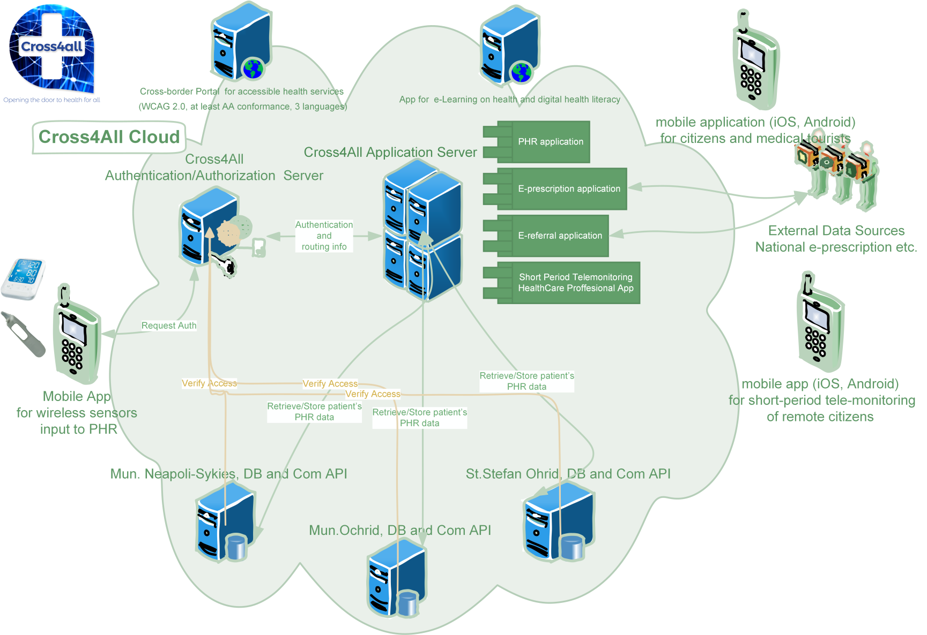
Cloud Only

Slide 4
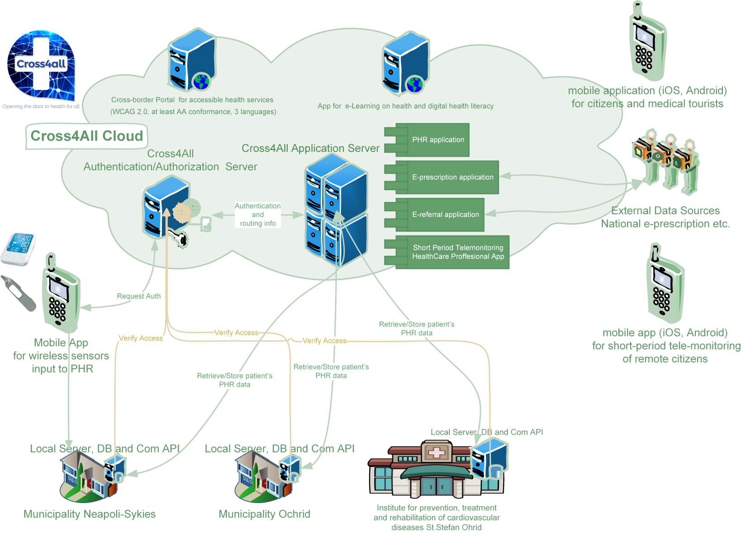
Cloud Infrastructure – Locally administered DBs

Slide 5
Devices
Not all devices part of all pilots. The proposed device pool per category:
Glucometer
  Medisana MEDITOUCH2
  FORA Diamond Mini
Blood Pressure Monitor
  Medisana BU550
  A&D UA-767PBT-Ci
Stethoscope
  TBD
Portable ECG
  Mortara Eli 230 (???)
Portable Ultrasound
  N/A
Spirometrer
  Vitalograph copd-6 with comms
Oxymeter (SpO2)
  Medisana PM150
Weight Scale
  AEG PW 5653 Black
Activity Tracking
  Xiaomi Mi Band 1S
Ear Thermometer
  Fora ir-20b

