Slide 1
Progress and plans at local level
Presentation of Municipality of Neapolis-Sykeon (PB5)
2nd Project Meeting, 4-5 October 2018
Host: University of St. Kliment Ohridski – Bitola, FIKT (PB2)
Venue: Meetings Room, Building of Rectorate – Military Complex (near Faculty of Law), University of St. Kliment Ohridski – Bitola, Bitola

Slide 2
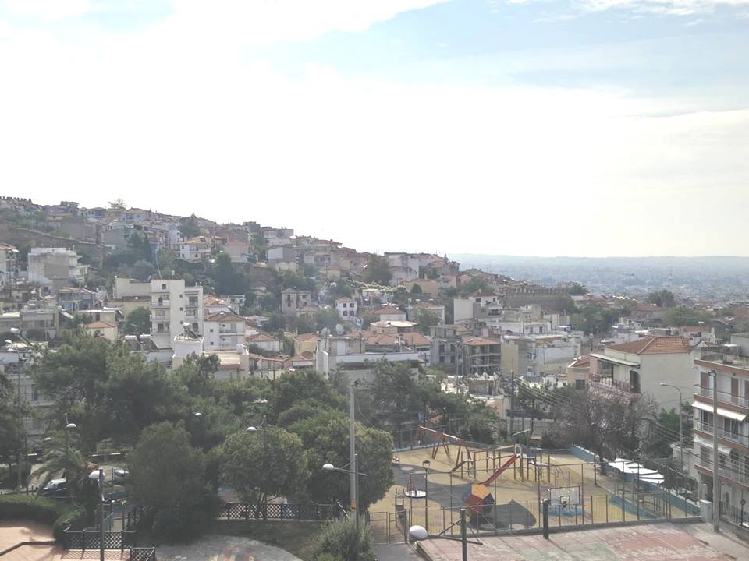
Good morning from the Municipality Neapolis-Sykeon!

Slide 3
What are our interests / expectations in the Project
Interests
State-of-the-art technologies for providing high quality health services to citizens
Novel approaches for reaching / supporting isolated individuals
Expectations
Own an advanced platform for hosting the Electronic Health Records (EHR) of our beneficiaries
Receive significant experience / know-how out of the pilot programme in order to build upon it the next period’s municipal plans
Exploit, advance and promote existing municipal services and resources

Slide 4
Our main role in the Project
Help in elucidating the needs from the Municipal and the citizens’ perspectives
Contribute to know-how exchange and people-to-people activities for developing joint knowledge, strategies and plans
Organise specific special training events based on the project’s produced knowledge and resources
Prepare and run the Local Pilot in our Municipality, as proof-of-concept and real conditions testing of the Cross4all technologies and resources

Slide 5
Our main deliverables
One (1) Project publicity event (Opening Conference)
Contribution to the Joint Strategy and the Local Action Plan
Organisation of one awareness seminar and two special workshops
Prepare and run the Local Pilot in our Municipality, as proof-of-concept and real conditions testing of the Cross4all technologies and resources
Acquisition of equipment for the Local Center (info points and devices for preventive health checks) and for the mobile / telemonitoring programme
Implementation of the Pilot Programme incl. the operation of the Mobile Unit

Slide 6
Short term plans (6 months)
Assign staff to the project
Prepare the tender for the consulting services
Organise the opening conference -postponed
Participate to the project study visits

Slide 7
So far: Municipality of Neapoli-Sykies started all the formal procedures for the implementation of Cross4all project
The municipal budget amendement
The establishment of the Project Team & the assignment of tasks etc under WP 1.
Representatives actively participated and contributed to the project kick-off meeting on 5 and 6 June 2018 ( WP 1)
Further, municipal services are preparing the tenders for the procurement of medical equipment and services, under WP 4, 5 and 6.
In particular, two procurements are under preparation:
I. a procurement bid for the supply, installation and maintenance service for 3 public (indoor) interactive workbenches (WP4), provision, installation and maintenance of 4 complete sets of equipment (tablet, wireless sensors for vital sign recording (heart rate, heart pressure, spirometer, cardiograph, weight scale, body temperature, and arterial oxyhemoglobin saturation (Sp02), etc.) under WP 5
and II. a procurement bid for services, under WP 6.
The recruitment call for a local project manager assistant is to be published shortly

Slide 8
Planned activities until M12
(Starting dates)
January 2019: Organization of a 3day seminar
April 2019: Provision of medical equipment and services
May 2019: Organization of a one-day Public Project Event
September 2019: Recruit experts team for the local center
September 2019: Helpdesk for vulnerable groups

