Slide 1
Progress and plans at local level
Presentation of PP2 Faculty of information and communication technology Bitola
2nd Project Meeting, 4-5 October 2018
Host: University of St. Kliment Ohridski – Bitola, FIKT (PB2)
Venue: Meetings Room, Building of Rectorate – Military Complex (near Faculty of Law), University of St. Kliment Ohridski – Bitola, Bitola
Presenter: Gabriela Miloshoska

Slide 2
Contents of the Presentation
In your presentations, please provide information on the following items:
Progress and current status per Deliverable of the partner (see JoB)
- Evaluation of public call for engagement of project stuff
Planned activities until M12
  activities and expected outcomes
  time plans
  input from other partners needed – ( for all activities)
  Risks and issues to be considered

Slide 3
Contents of the Presentation
Planned activities until M12
  Analysis of Accessibility of the e-Learning Platforms According to the WCAG 2.0 Standard Compliance and decision about the selected platform – prepared conference paper
  Analysis of the e-health activities in our country (e-health - need, reality or meet?) – prepared paper for AIIT
  Analysis of Electronic Health Record for Health Data Exchange
  Analysis of state e-referral and e-prescription system (possibilities of future connection with CROSS4ALL activities) – part in the paper
  Web system for increasing knowledge for digital health literacy, e-learning activities in compliance with WCAG2.0 – prepared materials for e-literacy (college with students)
  time plans for e-Learning platform have to be set
  WCAG2.0 standards and information from NCDP for web site (input from other partners needed) – prepared material – conference paper
  Technical issues about mobile platform for e-health: FDA approved and cleared appliances for measurement of vital signs - propositions
  Risks and issues to be considered

Slide 4
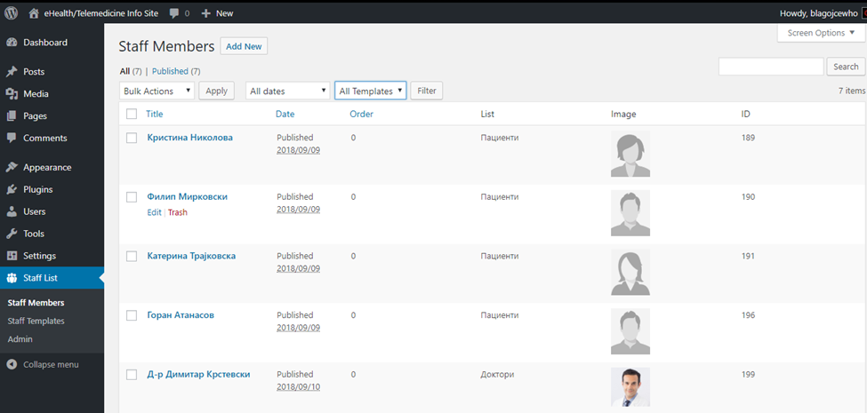
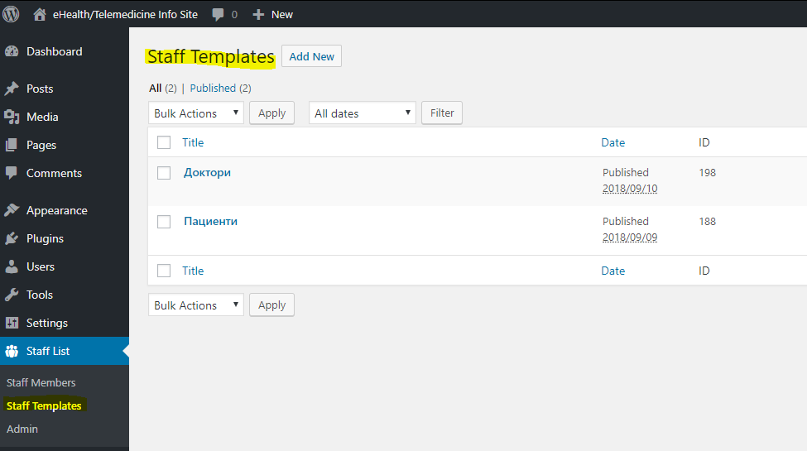
Draft version of the local application for available medical staff for the Project

Slide 5
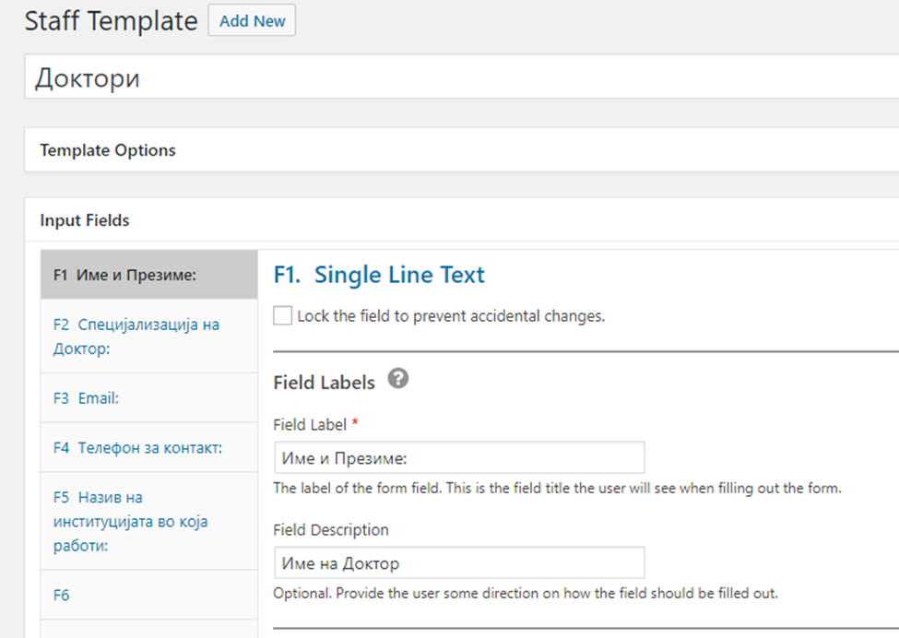
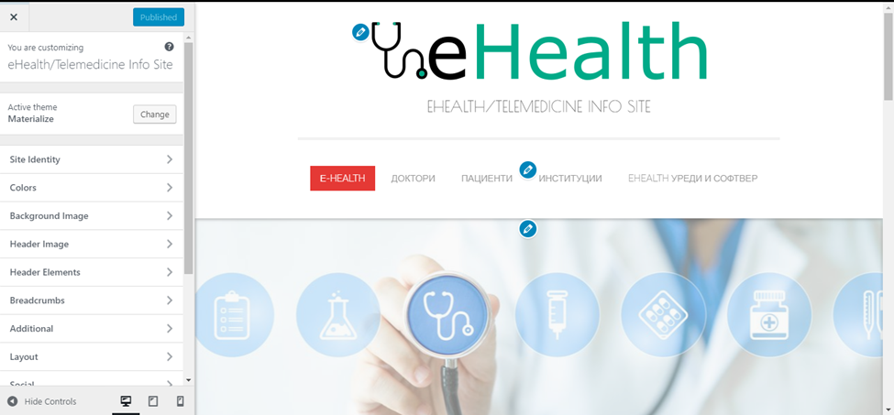
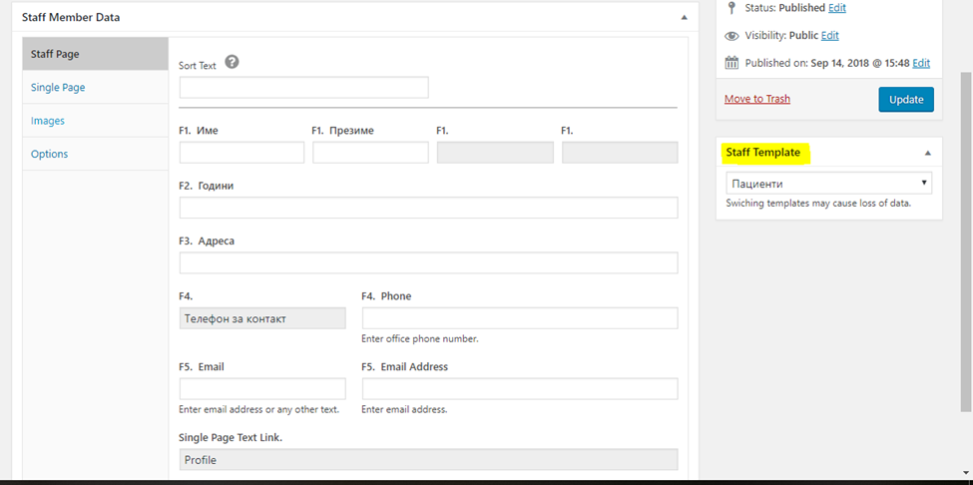

Slide 6
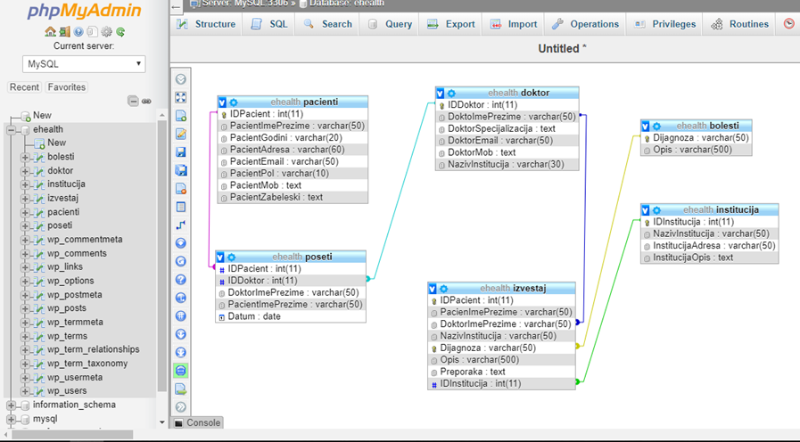
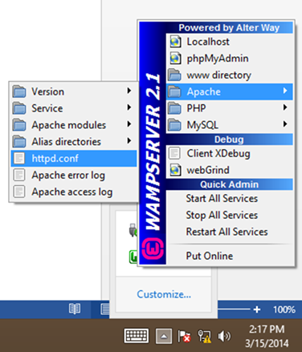

Slide 7
Methodology used for Analysis of E-Learning Platforms through WCAG 2.0
The accessibility testing and evaluation using an analytical method and criteria of accessibility/usability and users’ experience (WCAG 2.0)
Performed on the latest public version of the respective Learning management systems (LMSs) for common assistive technologies:
-Moodle
-Eliademy
-Docebo
-Sakai
-ATutor
The analysis covered the following types of impairments:
Visual, hearing and motor impairments

Slide 10
Concluding remarks about e-Learning platform
Each LMS has core features that cannot be modified and variable features which can be adapted for the specific accessibility requirements of people with disabilities. According to the CROSS4ALL requirements, the criteria from WCAG 2.0 Level AA compliance need to be satisfied
The final purpose is to provide website with e-leaning system that will increase e-health and medical digital literacy for the cross border region, including all partners’ contribution for cross border population with special focus on the elderly people, people with disabilities and children.
Our further testing will continue with evaluation of the criteria of Level AAA for Moodle and ATutor, as these two systems are particularly prominent in terms of availability for people with disabilities.

Slide 11
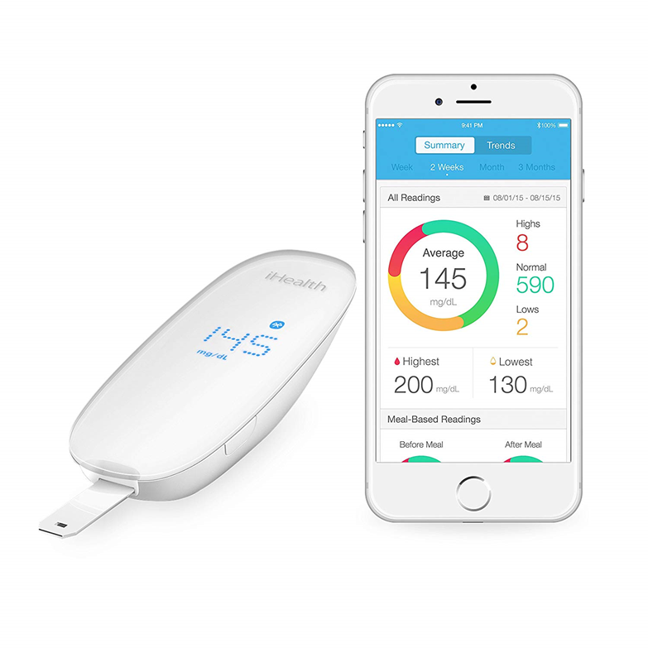
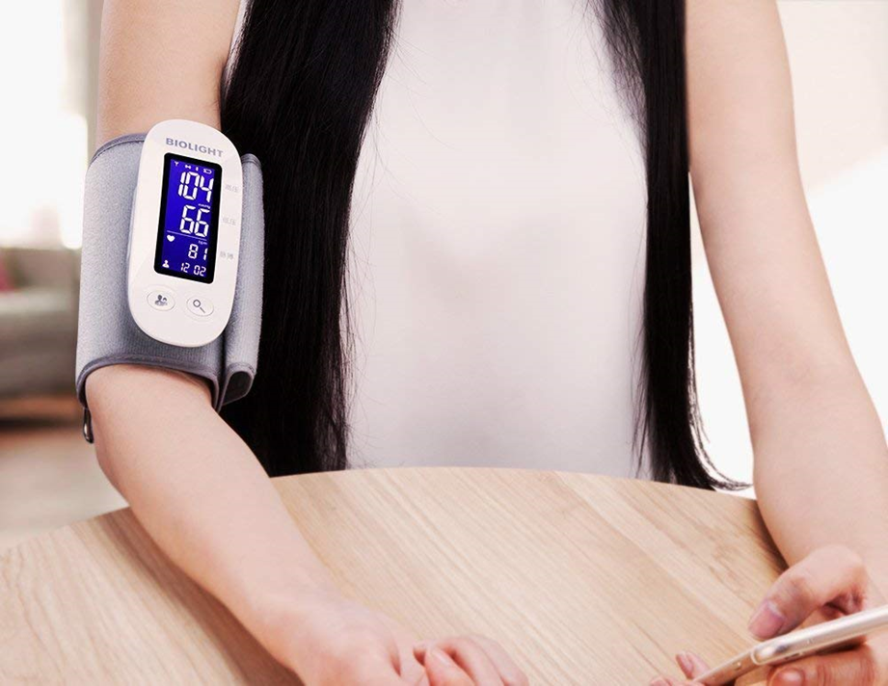
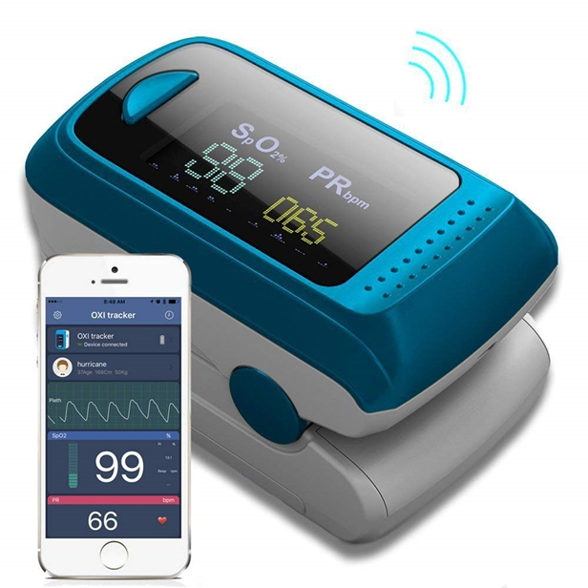
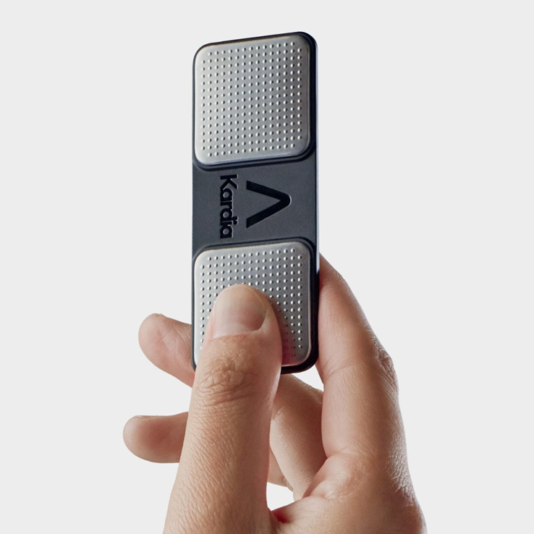
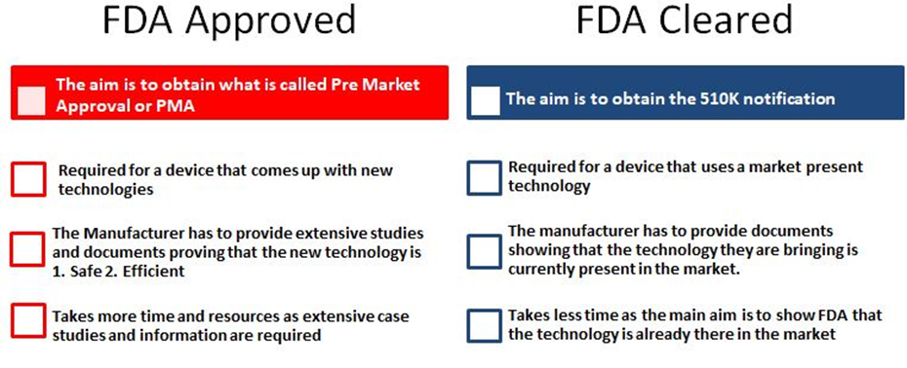
Multimedia tools Filmora and FL Studio for e-health literacy
https://drive.google.com/open?id=1jPGMhPUvm9eLGHv_GbQBQ1QPC2rEYt5L
https://goo.gl/FbB5xx

Slide 12
E-health, Need, Reality or Mith for R.of Macedonia
-The constant unstoppable trend of outpouring of medical staff in R. of Macedonia reduce the quality of public health service, especially in areas with a small number of inhabitants and people with disabilities.
The paper analyzes the current situation and proposes some possible improvements in actual healthcare system with usage of IT, using e-health concepts, also supported by CROSS4ALL IPA2 Project.
The project’s outcomes do not tend to be connected in this moment with state healthcare system, nor to enrich the state health care information system,
They have to give some possibilities for improvement of the model and adding a new possible enrichments in the three levels of healthcare systems, easy applicable in cross border areas and wider.
The proposed model includes integration of data in the base level.

Slide 13
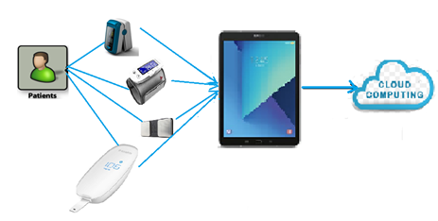
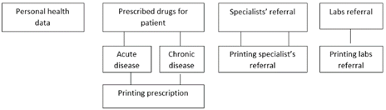
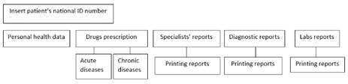
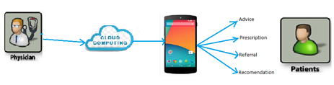
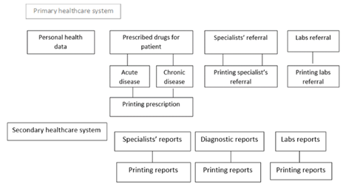

Slide 14
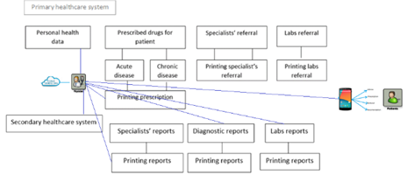
Proposed model with PH data and mobile units’ data

