Slide 1
State of Play on the Implementation of the Project
Presenter: Ioanna Chouvarda
2nd Project Meeting, 4-5 October 2018
Host: University of St. Kliment Ohridski – Bitola, FIKT (PB2)
Venue: Hotel Premier conference room, Stiv Naumov 12, 7000 Bitola

Slide 2
Intro
The purpose of this presentation is to give a detailed overview on the current status of the Project Cross4all and the progress made so far, since the KoM meeting (held on the 5th of June 2018), towards achieving its set objectives, as well as to focus on crucial issues regarding its successful implementation for the months to come

Slide 3
Achievements so far (general)
The subsidy contract of the project was signed on the 2nd of April 2018
Since then, several technical issues have been addressed and resolved from the project beneficiaries, following communication with the JTS/MA.
The kick-off meeting of the project took place at the Aristotle University of Thessaloniki Research Dissemination Center on 5-6 of June 2018
In total 17 participants representing all 6 project beneficiaries participated in the meeting, during which it was agreed the assembly of a Project Monitoring Committee (the main instrument for the Management and Coordination of the project), along with several other sub-committees and roles, incl. a Quality Control Group (responsible for monitoring and providing assistance to partners).

Slide 4
Achievements so far (general)
The assignment of leaders for each Work Package and Project Activity, as well as some minor modifications on the approved JoB that need to be requested were also discussed.
The first project report was filed.
Greek partners completed their registrations on ePDE
The consortium responded to the Communication Guidelines & Requirements for the Project Cross4All as set by Eleftheria Votsari, Communication & Technical Assistance Officer from the Joint Secretariat.
Most IPA partners (except PB6) completed their pre-financing requests procedures
Several technical telcos were conducted in the first months; yet, after the summer break partners did not participate effectively.

Slide 5
Achievements so far (per PB)
LB1 (AUTH):
  Organised, hosted and chaired the kick-off project meeting.
  Prepared and presented significant support and visibility material.
  Developed facebook page and Linkedin group.
  Registered the project on MIS (revised AF).
  Organised technical meetings -via skype- with partners.
  Prepared calls for recruiting project team members.
  LB1 assigned the Communication Manager and the Technical Coordinator of the Project.
  Worked on the WP4 and WP5 issues.

Slide 6
Achievements so far (per PB)
PB2 (FIKT):
  Drafted a modification request for its staff
  Joint several skype meetings
  Work started for WP4 and WP5 dels
  Prepared project's legal documents.
  Conducted technical meetings (virtual) with partners.
  Prepared the activities for this meeting in Bitola.
PB3 (NCDP) & PB5 (Neapoli-Sykies):
  key staff assigned to the project
  worked on the drafting of their tenders
PB4 (Ohrid) & PB6 (St Stefan):
  Formed the project team for project implementation and made the project registration in the Secretariat for European Affairs

Slide 8
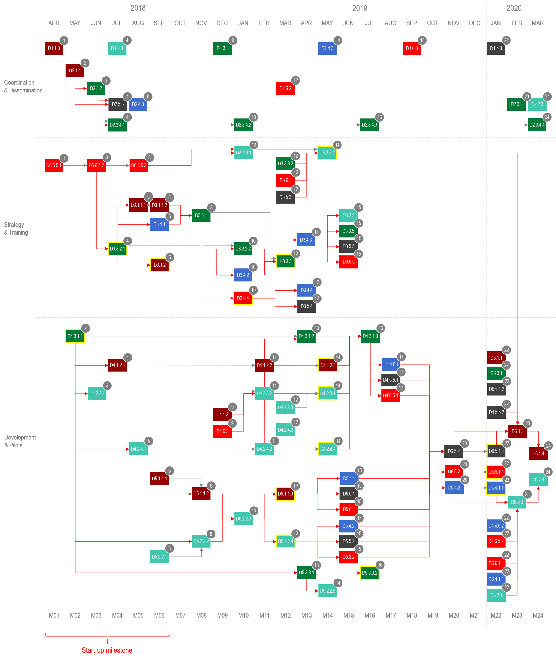

Slide 10
Next steps for project implementation
In the immediate future all beneficiaries will have to finish with the procurements procedures and have the necessary staff members to efficient implement the project, and provide the expected outcomes and results
Specifically, action needs to be taken for the completion of the communication plan
The study visits need to be completed (WP6)
The opening events (WP2) in Thessaloniki (PB3) and Ohrid (PB4) need to be completed
The Joint study (WP3) activities need to be organised and initiated
The joint development team needs to be completed (LB1, PB2, PB3), be fully functional and become more productive

Slide 11
Next steps for project implementation
LB1 shall focus on (a) finalizing the communication plan, (b) WP4 & WP5 developments, (c) finalizing the tender for D3.1.1 (survey)
PB2 shall focus on (a) WP4 and WP5 developments, (b) completing the tender procedure for deliverable D.4.2.4
PB3 shall focus contracting the WP2 and WP3 activities
PB4 shall focus on WP3 activities - the corresponding contracts need to be signed
PB5 shall focus on completing their tender procedures at least for WP3
PB6 shall focus on (a) the organisation of the study visits, and on (b) WP3 activities

