Slide 1
Progress and plans of PB3
3rd Project Meeting, 19-20 March 2019
Host: National Confederation of Disabled People, Greece (PB3)
Venue: CAPSIS HOTEL, Monasthriou 16, 54629 Thessaloniki

Slide 2
Status of staff recruitments
Staff #1 - assigned
  Local Project & Financial Manager (D1.3.2)
  Person for reviewing the final strategy (D3.3.3)
  Member of the Monitoring & Support Committee for the Pilot Programme (incl. equipment acquisition)

Slide 3
Status of staff recruitments
WP | Del. | Item | Brief justification of the expenditure (Max 350 Characters)
WP1 | D1.3.2 | Project manager | 1 Person responsible for the management of the project (reporting, monitoring, etc.) - part time (24 months X 20 hrs per month)
WP3 | D3.3.3 | Technical Staff | 1 Person responsible for reviewing and editing the Final Deliverables of NCDP (Contribution to Joint Strategy and Action Plan with emphasis on inclusive social/health care practices, Guide in print and accessible formats for people with disabilities)
WP6 | D6.3.3 | Technical Staff | Member of the Monitoring & Support Committee for the Pilot Programme of the Municipalities (P2 and P5). 6 months X 56 hrs / month X 15€ per hour

Slide 4
Status of Tenders
Tender #1:
  Related to: D1.3.5 – FLC (assigned)
  Budget: €5.000 (incl. VAT)
  Status: Contract to be signed
Tender #2:
  Related to: D1.3.4 (External management support)
  Budget: €11.904,00 (incl. VAT)
  Status: Tender closed,
  Contract signed on 18.02.2019
Tender #3 (Open electronic tender):
  Related to: All external services
  Budget: €186.580,00 (incl. VAT)
  Status: Decision taken on 04.03.2019 for
  announcing the tender and
  uploading on ESYDYS the documents
D2.3.2 Communication material and tools
D2.3.3 Public Project Events
D2.3.4 Project website (WCAG 2.0, AA)
D3.3.1 Joint study of needs and gaps
D3.3.2 Inspections and data collection
D3.3.3 Common strategy & action plan
D3.3.3 Common strategy & action plan
D3.3.5 Awareness and activation raising campaign
D3.3.5 Awareness and activation raising campaign
D4.3.1 Cross-border Portal for accessible health services
D5.3.3 Mobile app for citizens & medical tourists

Slide 5
Implementation progress and status
Contract was awarded to subcontractor for project management support (see D1.3.4)
Participation to all project meetings (3 meetings)
Participated in the MIS training seminar in Thessaloniki (30.11.2018).
Provided comments and feedback for the drafting of the LB1 Tender for D3.1.1 (Survey on needs and gaps).
The tender documents for an Electronic Open Tender according to L.4412, in relation to deliverables D2.3.2, D2.3.3, D2.3.4, D3.3.1, D3.3.2, D3.3.3, D3.3.5, D4.3.1 and D5.3.3, were drafted, and approved by the PB3 decision boards on 04.03.2019. Will be announced next week.

Slide 6
Status of expenditures
Paid out and verified expenditures until 28.02.2019
  Contracted: €19.104 (9%)
  Paid out: €3.441,65 (1,6%)
  Verified: €0,00 (to be contracted these days)
Expected paid out expenditures until 31.03.2019 (in order to assess the risks in relation to the 20% rule of the Programme)
  Total: €3.888,50 (1,8%)

Slide 7
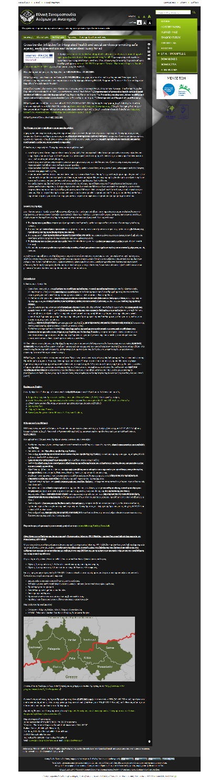
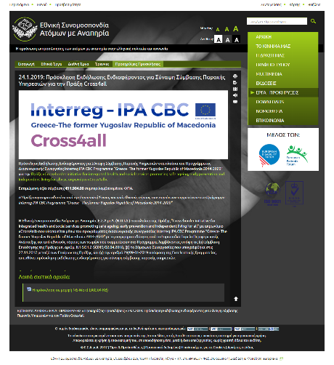
Publicity outcomes and plans
OUTCOMES:
PB3: Announcement of the Project on PB3’s web page: http://tiny.cc/wj0f2y
PB3: Announcement of the tender #2 on PB3’s web page: http://tiny.cc/b8s83y
Poster of the project, developed using the MA's “Poster Development Tool” and placed it in visible places of the premises of PB3 (Athens, Thessaloniki)
PLANS:
Communication material & tools (D2.3.2)
Closing (or Opening) event Thessaloniki (D2.3.3)
Project website (WCAG 2.0, AA) (D2.3.4)

