Slide 1
Progress and plans at local level
Presentation of PP2 Faculty of information and communication technology Bitola
3rd Project Meeting, 19-20 March 2019
Host: National confederation of Disabled people – Grece, NCDP, (PB3)
Venue: Capsis Hotel – Thessaloniki
Presenter: Snezana Savoska

Slide 2
Contents of the Presentation
In your presentations, please provide information on the following items:
Progress and current status per Deliverable of the partner (see JoB)
- Evaluation of public call for engagement of project staff
Planned activities
  activities and expected outcomes
  time plans
  input from other partners needed – ( for all activities)
  Risks and issues to be considered

Slide 3
Contents of the Presentation
Planned and realized activities until March 2019
  Analysis of Accessibility of the e-Learning Platforms According to the WCAG 2.0 Standard Compliance and decision about the selected platform
  Selected ATutor platform as the most convenience for our purpose
  Analysis of the e-health activities in our country – D.3.2.3 (for the first draft of strategy – with partners) – activity is not yet started for payment..
  Analysis of Electronic Health Record for Health Data Exchange (D.4.2.3 and D.2.2.4)
  Analysis of state of procurement for e-referral and e-prescription system D.4.2.4 – finished procedure for procurement of external expertise
  Web system for increasing knowledge for digital health literacy, e-learning activities in compliance with WCAG2.0 – prepared materials for e-literacy – D.2.2.4 – launched local web site...we are waiting for:
  Input from NCDP for web site (input from other partners needed) – prepared material for e-learning platform
  Technical issues about mobile platform for e-health: FDA approved and cleared appliances for measurement of vital signs - checking
  Risks and issues to be considered

Slide 4
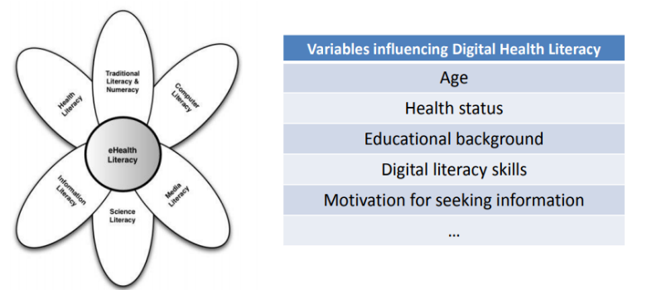
e-Learning web platform (D4.2.3)
offer access to eLearning for citizens (health & digital health literacy)
A Visitor (citizen) can be informed of the existence of a special eLearning platform and be redirected to it in order to:
register to special courses related to health literacy (the ability to obtain, read, understand, and use healthcare information in order to make appropriate health decisions and follow instructions for treatment, e.g., for addressing or solving various health problems.
register to special courses related to digital health and e-health literacy (set of skills, knowledge, and attitudes that a person needs in order to (a) seek, find, and appraise health information and services from electronic sources, and (b) to find, select and make effective use of available tools (PHRs, devices, mobile apps, etc.)

Slide 5
e-learning team activity:
Month | responsible | Planed activity | Finished activity | Notes
June | e-learning team | Team building
 | e-learning team | Studding the criteria of WCAG 2.0 standard
July | e-learning team | Studding the criteria of WCAG 2.0 standard and e-learning platforms testing
August | e-learning team | Studding the criteria of WCAG 2.1 standard and testing selected e-learning platforms
September | e-learning team | Analysis of accessibility of different e-learning platforms
October | e-learning team | Analysis of accessibility of different e-learning platforms
 | e-learning team | Presentation results of analyzing process
November | e-learning team | Downloading and installing of the Atutor platform
December | e-learning team | Test period of the downloaded and installed ATutor platform according WCAG criteria
 | Project manager | Invitation for tender submission - Translation to/ and from Macedonian to English / Greek languages
 | Project manager | Invitation for tender submission- Expert usability & accessibility evaluation to assess conformance with WCAG 2.0 (AA) and Impact assessment study
January | e-learning team | Posting materials / courses related to digital health l health literacy, collaboration with PB6, PB3 | No | we are waiting a material from our partner
 | Evaluation team | Evaluation of tender | yes
February | e-learning team | Posting materials / courses related to digital health l health literacy, collaboration with PB6 and PB3 | No | we are waiting a material from our partner

Slide 6
PHR - mobile app for citizens (D5.2.2)
allow citizens to:
create and maintain their own ePHRs (optionally, with the support of the staff of the centres)
import data to their own ePHR, automatically from connected/supported devices
share data of their ePHRs, in a user-friendly manner, with health professionals across the borders
PHR mobile app for citizens or use a mobile set of devices provided by Cross4all (see D5.x.2) to:
  store new data to and view his/her own PHR, receive notifications related to his medical plan, doctor visits, store/view vital signals collected with health devices / sensors (see D5.x.2), share data with professional within or across the boarders
Equipment
Provision, installation and maintenance of 4 complete sets of equipment (tablet/mobile, wireless multi sensor for vital sign recording (heart rate, heart pressure, breath rating, body temperature, glucometer, etc.) for development testing the PHR mobile app for citizens

Slide 7
PHR - mobile app for citizens (D5.2.2)
Month | responsible | Planed activity | Finished activity | Notes
June
July
August
September
October
November | Ilija Jolevski, Aleksandar Markoski | Testing mobile equipment for data transferring possibilities
December | Ilija Jolevski, Aleksandar Markoski | Testing data transfer between cloud repository of the equipment vendor and local computer (or cross4all cloud) | Available devices | Lack of equipment
January |  |  | Bluetooth testing
February | Ilija Jolevski | Researches for data availability of the vendors’ cloud systems | Bluetooth conectivity

Slide 8
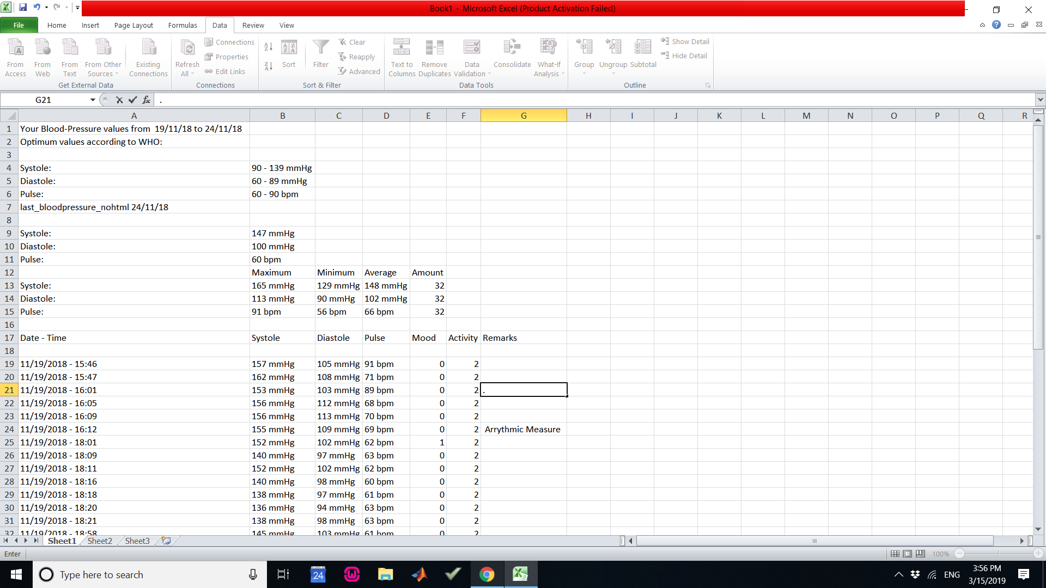
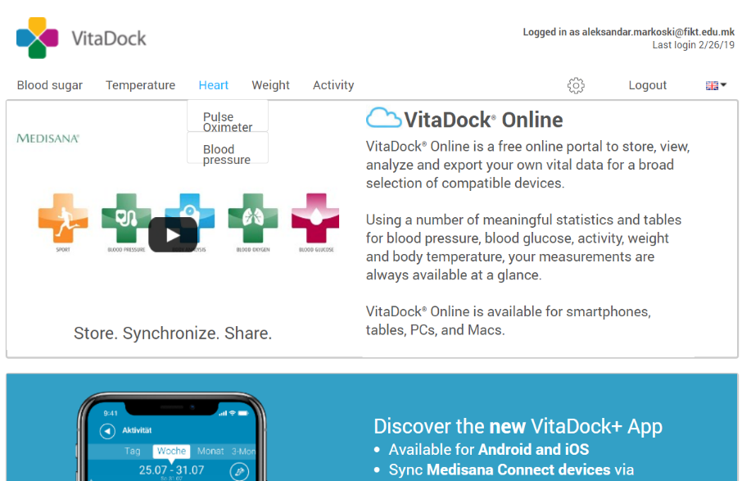

Slide 9
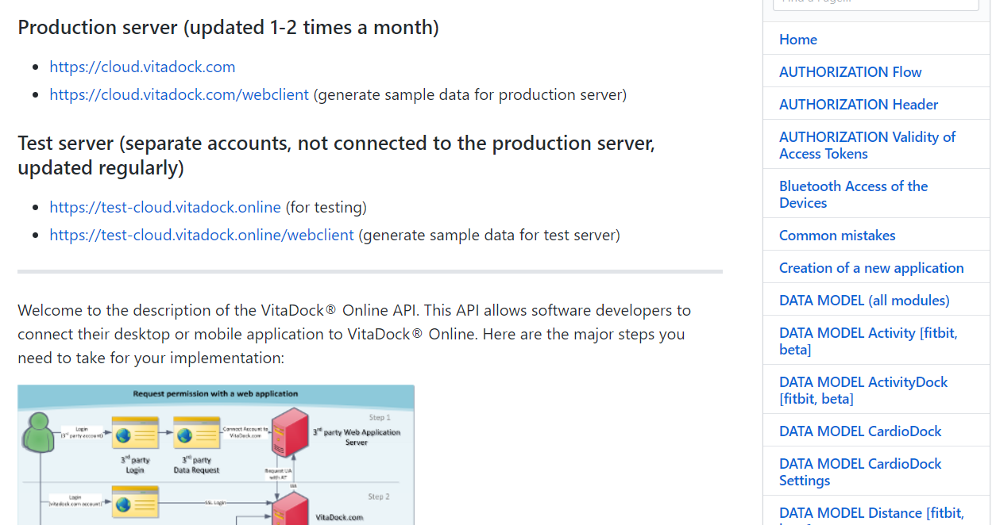
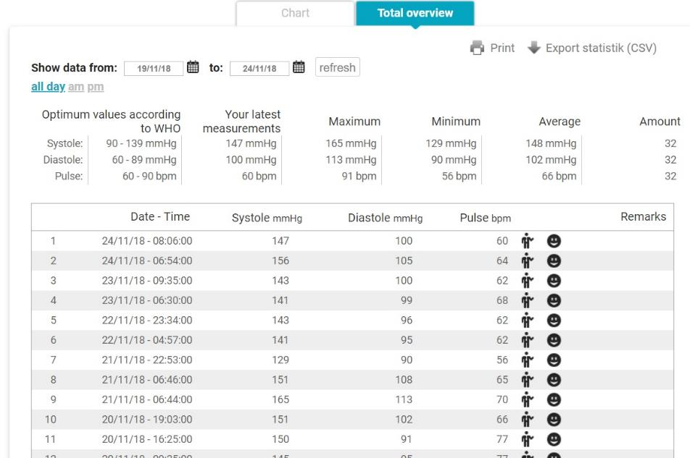
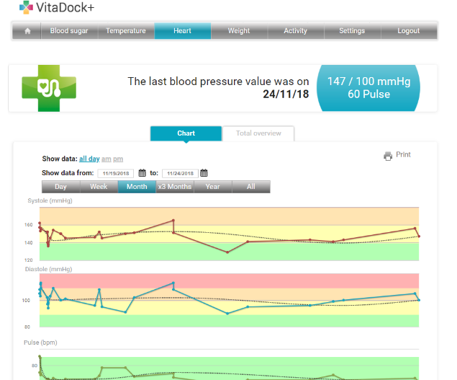

Slide 10
e-Prescription & e-Referral (D4.2.4)
allow automatic (i.e., easy and free of error) importing of data from third party systems that it interfaces with (e.g., existing healthcare electronic systems of various healthcare authorities, including national prescription systems, hospital electronic systems, private telecare services, etc.)
PHR owner (citizen) may visit any Health service professional who has access to a Connected third-party system (see D4.2.4) and:
  precondition: has granted the professional access rights (temporary or not) to view parts or whole of his/her PHR data,
  view parts or whole of the patient’s PHR data, through his / her e-Prescription & e-Referral systems
  precondition: has granted the professional access rights (temporary or not) to add / upload new data to his/her PHR data, add / upload data to the patient’s PHR through his/her e-Prescription & e-Referral systems

Slide 11
e-Prescription & e-Referral (D4.2.4)
Month | responsible | Planed activity | Finished activity | Notes
June 2018
July
August
September
October | Project manager | Studying project requirement for e-prescription and e-referral | Yes
 | Project manager | Studying PRAG procedure for procurement of service for this tender | Yes
November | Project manager | Preparing tender documentation | Yes
December | Project manager | Preparing tender dossier | Yes
 | Project manager &FM & AS | Invitation for tender submission- Development for e-Prescription and e-Referral systems | Yes
January 2019 | PM@Assesment team | Selection of best tender | Yes
February 2019 | Project manager | PRAG documents for selection and announcement of the selected tender | Yes

Slide 12
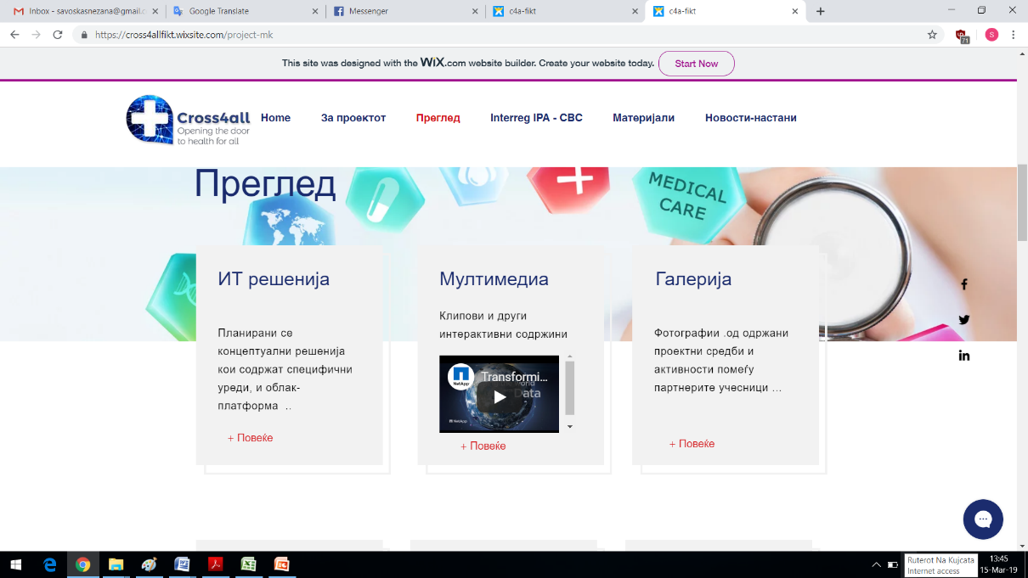
IV. Other activity: web site & other
https://cross4allfikt.wixsite.com/project-mk

Slide 13
Month | responsible | Planed activity | Finished activity | Notes
June | e-learning team, PM | Creating paper for e-Accessibility and WCAG standard
 | e-learning team, PM | Researches about the published papers for WCAG standards and experience with implementation of the standards
 | Web administrator | Preparing materials for cross4all FICT web site
July | PM, mobile team | Creating video materials for usage of mobile devices for vital sign
August | e-learning team, PM | Researches about the published papers for WCAG standards
September | e-learning team, PM | Creating paper for e-Accessibility and WCAG standard
October | Web administrator | Creating cross4all FICT web site
 | e-learning team, PM | Paper presentation on AIIT2018
November |  | Paper presentation on ISGT2018 Updating the cross4all-FICT web site
December | Project manager | Invitation for tender submission - for Organization of one three-day seminar and Payment for two special adult trainers, to prepare the educational material and conduct one-day training for the project CROSS4ALL posting the invitation for tenderers to the FICT and cross4all-FICT web site
 | Project manager | an advertisement for engaging outsiders as staff to work on creating mobile applications D.5.2.2
January | PM@Assesment team | Selection of best tender – there is not submitted tenders
February |  | Exploring the mobile devices for monitoring vital signs for distance citizens
March | PM@AT | Selecting outsiders as staff
 | Project manager | Preparation of Second Invitation for tender submission- Expert usability & accessibility evaluation to assess conformance with WCAG 2.0 (AA) and Impact assessment study
 |  | Preparation of Second Invitation for tender submission - for Organization of one three-day seminar and Payment for two special adult trainers, to prepare the educational material and conduct one-day training for the project CROSS4ALL
 |  | Preparation of tender dossier for procurement of 4 complete sets of equipment (tablet/mobile, wireless multi sensor for vital sign recording) (heart rate, heart pressure, breath rating, body temperature, glucometer, etc.)
 |  | Contracts with outsiders as staff cost working on D.5.2.2.

Slide 14
  Problems, Risks and issues to be considered
Why we late with planned activities?
Waiting for material for e-Learning on health and digital health literacy
Mobile devices for vital signs – technical decision for devices
Procurement procedures starts in November because lack of funds
No decision for some tenders – may be we have high criteria? Or low level of planned funds?
Lack of staff for mobile devices D.5.2.2 – we start procedure for recruiting staff and outsiders…in December - procedures are not finished yet..
Procurement procedure for mobile devices
Procurement procedures for two unsuccessful tenders…
Question: Did we have a high level of demands in tenders? May be we have to lower the tenders’ criteria….
Question: When we can expect the material for e-learning for digital literacy for e-health for e-learning platform?
-They have to be the base for our three days workshop?
- When we have to planning these activity?
- Do we expect some project prolongation? Can we catch the planned dynamic?

