Slide 1
State of Play
Presenter: Ioanna Chouvarda
3rd Project Meeting, 19-20 March 2019
Host: National Confederation of Disabled People, Greece (PB3)
Venue: CAPSIS HOTEL, Monasthriou 16, 54629 Thessaloniki

Slide 2
Introduction
The purpose of this first presentation is to provide and short overview on the current situation in the Project, and to:
highlight the progress made so far
identify key issues & critical delays in relation to the original plans
derive the main topics that we need to focus and discuss upon
set the primary objectives of this meeting

Slide 3
2nd Progress Report (9 months in the project)
Overview and key conclusions

Slide 4
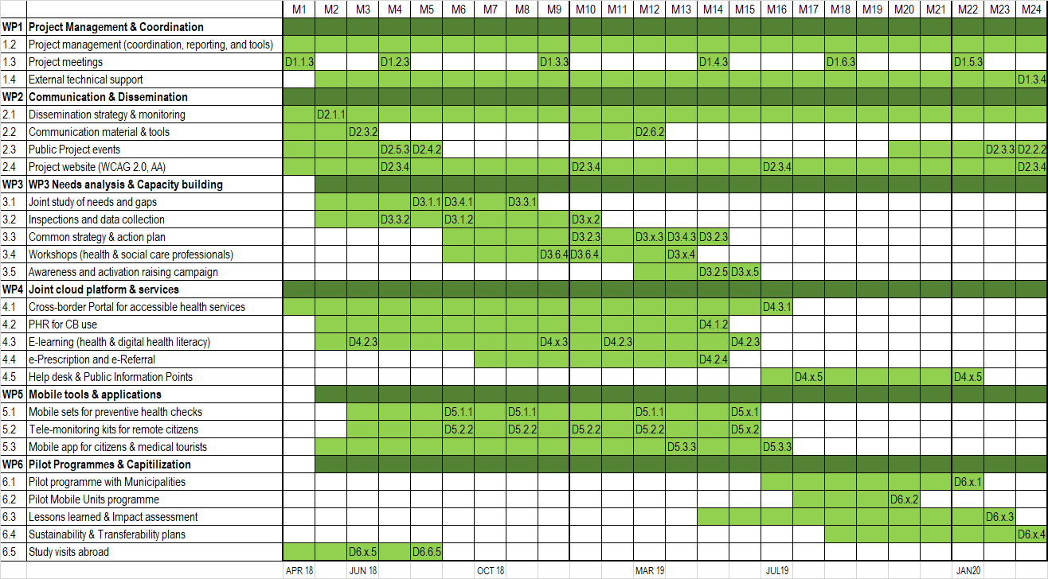
2nd progress
report

Slide 5
Spending on the project:
LB1 = €28.868,36 (11,5%)
PB2 = €510 (0,3%)
PB3 = €2.441,65 € (1,1%)
PB4 = €897,95 (0,6%)
PB5 = €3642,58 (1,7%)
PB6 = €816,63 (0,6%)
Total = €37177,17 (3,25%)
JUL-DEC 2018
2nd progress
report

Slide 6
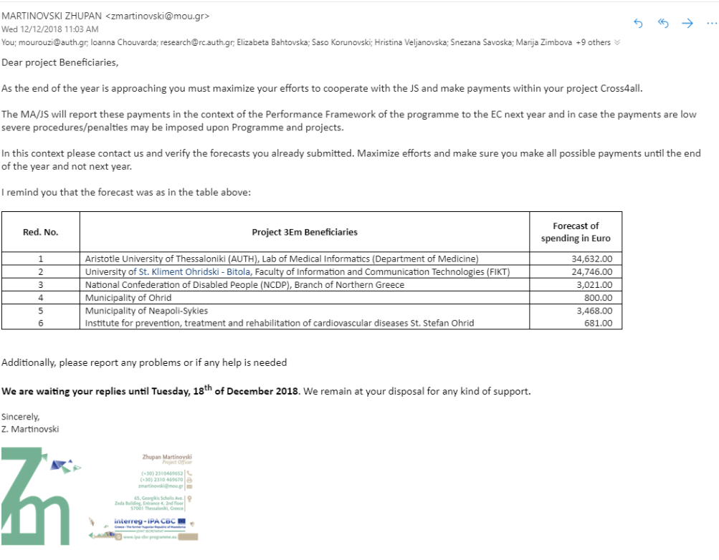
2nd Progress Report (9 months in the project)
€67.348 (5,88%)

Slide 7
2nd Progress Report (9 months in the project)
Key conclusions:
PB2-PB6 made almost no expenditures in the Project
This is also reflected in the reported achieved outcomes and results:
  PB2: Request for budget modification which does not affect the total budget of each deliverable concern changes in rates and units).
  PB3: Completed drafting all tender documents (WP2-WP5)
  PB4: The project was registered in the Public tax revenue office; request for budget modification, with proposal to reduce WP6 (D6.4.1 and D6.4.2) external service for professionals in the pilot and mobile programme, for provision of new equipment (a car for the pilot and mobile programme)
  PB5: Programming of WP5 work; Activity 5.1: Mobile sets for preventive health checks & Activity 5.2 Tele-monitoring kits for remote citizens.
  PB6: Organized activities for upcoming study visit in the Netherlands; Organisation of event for promoting collaboration with EU and presenting Cross4All Project.

Slide 8
Start-up period (9 months in the project)
These figures can induce serious questioning by the JTS, and even budget reductions
[…] the project is with significant delay of the actions, and spending of funds with most of the partners is problematic (particularly in 2018).
Zuphan Martinovski (18.03.2019)
A serious challenge:
According to the Project Implementation Manual (paragraph 2.4.3), at the end of the start-up period, the project shall undergo an internal review with the responsibility of the LB in order to assess whether the milestones have been met by all partners.
The results of this internal review shall be brought forward to the JS/MA and it shall be assessed whether corrective or any other actions are necessary.
In case of major delays and non-achievement of the milestones leading to possible failure of the project scope, the JS/MA reserves the right to propose reduction of the physical object and/or reduction of the budget, given that the project will remain operational.

Slide 9
Start-up period (9 months in the project)
[…] Please consider that the startup period for Cross4all project has ended on 01/12/2019 (the Subsidy Contract is signed on 2/04/2018), so you must provide status of the realized and activities initiated in this period according the submitted start-up plan, as well the clarification and corrective actions if needed.
Zuphan Martinovski (18.03.2019)

Slide 10
From the beginning of 2019 until today
Overview of progress & major delays

Slide 11
Opening events in Ohrid and Thessaloniki
Project dedicated website
JUL-DEC 2018
2,5
months
today
Limited publicity outcomes & results

Slide 12
Preliminary studies on needs
Services and accessibility assessment
Study visits
JUL-DEC 2018
2,5
months
today
Pushing behind the common strategy & the workshops

Slide 13
E-learning (s/w & content)
JUL-DEC 2018
2,5
months
today

Slide 14
Mid-term (12 months)
Major challenge ahead

Slide 15
Mid-term (12 months)
Also according to the Subsidy Contract (par. 3.7 ), in case that
one (1) year after signing of the subsidy contract the total verified expenditure reported in the progress reports, with regard to the previous year, is less than 20% of the total project budget, the Joint Monitoring Committee, based on the proposal of the Managing Authority, may decide to reduce the budget of the project.
If the reduction of the project budget is decided, this contract and respective annexes will be modified accordingly.

Slide 16
Mid-term
(20% rule)
Finish the developments
today
Run the pilots

Slide 17
Main topics and objectives for this meeting
Discuss and agree on the reporting of the status of the realized and activities initiated in this period according the submitted start-up plan
Identify and address the risks in relation to the mid-term 20% rule (forecast of paid out and verified expenditures)
Plan and ensure the delivery of delayed outcomes
  The study visits need to be completed (WP6)
  The opening events (WP2) in Thessaloniki (PB3) and Ohrid (PB4) need to be delivered
  The joint study and the inspections (WP3) activities need to be planned and delivered
  The e-learning developments (A4.3) need to be completed

Slide 18
Main topics and objectives for this meeting
Review last meetings goals vs. performance:
  LB1 shall focus on (a) finalizing the communication plan, (b) WP4 & WP5 developments, (c) finalizing the tender for D3.1.1 (survey)
  PB2 shall focus on (a) WP4 and WP5 developments, (b) completing the tender procedure for deliverable D4.2.4
  PB3 shall focus contracting the WP2 and WP3 activities
  PB4 shall focus on WP3 activities - the corresponding contracts need to be signed
  PB5 shall focus on completing their tender procedures at least for WP3
  PB6 shall focus on (a) the organisation of the study visits, and on (b) WP3 activities

Slide 19
Main topics and objectives for this meeting
Continue technical coordination and progress towards:
  Finishing the developments
  Completing the preparations for the pilots
The action plan for each partner, for the next period needs to be made clear and binding
Additional measures need to be discussed and agreed (to enhance publicity, project extension, etc.)

Slide 20





Ioanna Chouvarda
Assistant Professor
Lab of Computing, Medical Informatics, and Biomedical Imaging Technologies, Aristotle University of Thessaloniki

