Slide 1








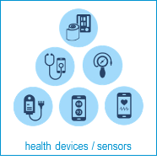


What a citizen (Visitor or PHR owner) could do alone, without involving:
Local Support/Reference Center(s)
Connected Service Provider(s)
Cross-border
web portal (D4.3.1)
Info & resources database
1
6
CB mobile app
for citizens (D5.3.3)
PHR web
platform (D4.1.2)
2
4
e-Learning
database
D5.x.2
PHR database
3
e-Learning
web platform (D4.2.3)
7
PHR mobile app
for citizens (D5.2.2)

Slide 2

About the
Cross4all Reference Centers
To further support the management of citizen’s PHRs, the concept of Local Support/Reference Centers is introduced, which shall help the citizens to:
  improve their self-awareness and self-management
  increase their awareness and about the project’s tools / services
  provide user/technical support to system users
  generate and maintain an accurate PHR (health logistics)
These Centers shall be staffed with experts and shall be equipped appropriately, in order to be in the position to:
  provide information about available healthcare infrastructures and services at both sides of the border, including access and accessibility information
  act as an information center for citizens and help desk for medical tourists
  offer personal support for PHR management onsite (for active citizens)
  offer personal support for PHR management at the citizen’s space (for socially and geographically isolated individuals), though a pilot mobile units programme
In this project (WP4 and WP5), the components of an innovative integrated cloud-based platform will be developed for promoting better management and use of citizens’ personal health records
including cross-border use
with particular focus on serving the needs of elderly and people with disabilities and socially / geographically isolated individuals
(See overview of high-level functionality of the Cross4all subsystems)
Note: This does not include the additional requirements that correspond to the “Pilot health pre-check service” provided in the context of WP6 pilots (this is covered in later slides)

Slide 3
About the
Cross4all Reference Centers
Overview of the services:
  offering information on healthcare services in the region, including information about access and accessibility
  providing information on the operation of a volunteer programme
  providing information about resources for citizens
  providing information about available resources for professionals
  providing information about the ePHR, eLearning, e-Prescription and e-Referral of Cross4all
  providing assistance to citizens for learning how to use / manage their own PHR
  providing assistance to citizens for initiating/configuring their own PHR
  providing a service for digitizing their paper-based records
  providing a service for uploading data to citizen’s PHRs on their behalf
  operating a help desk (telephone, email, web based)

Slide 4
About the
Cross4all Reference Centers
Space requirements
  A public space (room), where the Public Information Points (see D4.x.5) are installed and available for free use
  An office for the Onsite Support Expert(s)
  An office for the Help Desk Staff
Equipment requirements
  Public Information Points (see D4.x.5)
  Workstation(s) / peripheral(s) (see D5.x.1) for the Onsite Support Expert(s)
  Workstation and Telephone equipment (see D4.x.5) for the Help Desk Staff
  Tablet(s) / peripheral(s) (see D5.x.1) for the Mobile Support Expert(s)
Staff requirements
  Help desk staff (see D4.x.5)
  Onsite Support Expert(s) (see D6.x.1)
  Mobile Support Expert(s) (see D6.x.2)
Three (3) such Centers are foreseen in the project:
At premises of the Municipality Neapoli-Sykies (PB4)
At premises of the Municipality of Ohrid (PB4)
At premises of the Cardiovascular Diseases Clinic from Ohrid (PB6)
In the next slide, an overview of an “ideal” space and equipment set-up, in relation to the concept of Local / support Reference Centers is presented

Slide 5





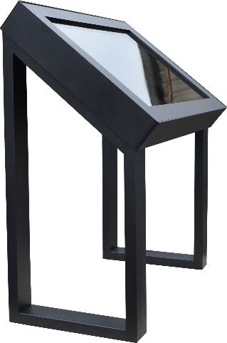

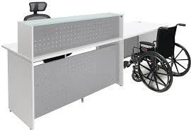
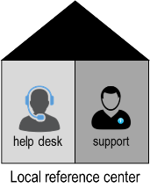
help desk’s office
Onsite support expert’s office
Cross-border
web portal (D4.3.1)
Telephone line / equipment (D5.x.1)
Workstation & peripheral(s)
Help desk’s unit
Cross-border
web portal (D4.3.1)
1
PHR web
platform (D4.1.2)
e-Learning
web platform (D4.2.3)
3
5
PHR web
platform (D4.1.2)
4
Public Information Point unit
public space
Entrance

Slide 6




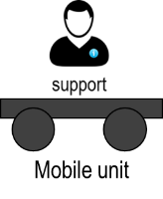
PHR database
Cross-border
web portal (D4.3.1)
PHR web
platform (D4.1.2)
5
Tablet & peripheral(s)
Citizen’s space

