Slide 1

About the
Connected Service Providers
As a first pilot step in this direction, the concept Connected third-party system is introduced, and pilot implementation of such as systems shall be developed in Cross4all (see D5.1.1 and D4.2.4).
This pilot system may be used by authorized staff of registered health service providers in the context of:
  offering to their clients (who own a Cross4all PHR) a personal healthcare service onsite (for active citizens)
  offering to their clients (who own a Cross4all PHR) a personal healthcare service at the space of the patient (for socially and geographically isolated individuals), though a pilot mobile units programme
Such personal healthcare services may include (indicatively):
  preventive health services
  diagnostic pre-assessment
  guidance
  prescription / referral services, etc.
As part of overall effort towards promoting better management and use of citizens’ personal health records, it is believed that the Cross4all integrated system should interface with third party systems and enable automatic importing of data from them (i.e., easy and free of error).
(See overview of high-level functionality of the Cross4all subsystems, points #8 and #9)
Such services providers can be special care structures of Municipalities, clinics, private doctors, private telecare providers, etc.)

Slide 2
About the
Connected Service Providers
Space requirements
  An office for the Onsite health professional(s)
Equipment requirements
  Tablet(s) and connected health devices (see D5.x.2) for the Onsite health professional(s)
  Tablet(s) and connected health devices (see D5.x.2) for the Visiting health professional(s)
Staff requirements
  Onsite health professional(s) (see D6.x.1)
  Visiting health professional(s) (see D6.x.2)
These are in addition to what was presented earlier, in relation to the concept of Local / support Reference Centers

Slide 3
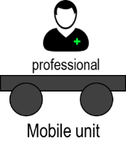
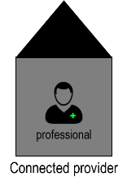
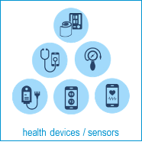









Patient’s space or Onsite
D5.x.1
PHR mobile app
for pros (D5.1.1)
8
e-Prescription &
e-Referral (D4.2.4)
9
Phr web
+
PHR mobile app for telemonitoring
Tablet & health sensors(s)
PHR database

Slide 4

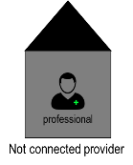
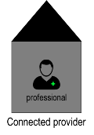


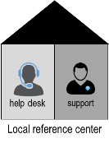
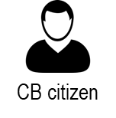
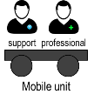


Out of town / country
Overview of
access & use
of systems and services,
in and out of borders
4
7
6
8
1
2
1
3
2
5
Not connected provider link to PHR database (if he has a C4A account)
6
5
8
8
9
Citizen’s city
3

