Slide 1

About the
Cross4all pilots
Two (2) such pilot deployments (pilot cases) are foreseen in the project:
One in Thessaloniki, where we shall have:
  one Center of reference (PB5)
  one Registered health service provider (PB5)
  one Multi-functional mobile unit (PB5)
One in Ohrid, where we shall have:
  two Centers of reference (PB4, PB6)
  one* Registered health service provider (PB6)
  one* Multi-functional mobile unit (PB5, PB6)
  (*) subject to the approval of the project modification requested by PB4
A Joint Monitoring Committee (staffed by LB1, PB2, PB3, PB4, PB5, and PB6) will be operating during the pilot programmes, for ensuring proper function, for identifying issues, gaps and good practices, and for assessing the effectiveness and efficiency of the services.
During the project, the developed components of the envisioned integrated cloud-based platform will undergo a pilot deployment and testing in real contexts (see WP6).
In this way, the partners will derive valuable lessons-learnt and shall be in better position to plan (a) the transition to functional deployment (sustainability) and (b) the addition of new reference centers and third party systems to the network (transferability).
Target (in total):
300 people will be offered social services (PHR management)
600 people will be offered free health check-ups and counseling, while high risk people will be directed to the appropriate medical and or care centers
These following slides depict the test scenarios to be conducted in each pilot (based on the category of target-groups involved in each scenario)

Slide 2






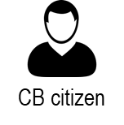


Target: no limit
User Category #1
Visitor, who does not turn into PHR owner
Cross-border
web portal (D4.3.1)
Info & resources database
1
CB mobile app
for citizens (D5.3.3)
1
2
2
e-Learning
database
3
Anywhere
3
e-Learning
web platform (D4.2.3)
Through:
citizen’s own device or
a public Cross4all infokiosk (see D4.x.5)

Slide 3






Target: no limit
User Category #2
PHR owner who does not interact with :
Local support expert(s)
Connected health service provider(s)
6
PHR web
platform (D4.1.2)
4
6
PHR database
Anywhere
4
Through:
citizen’s own device or
a public Cross4all infokiosk (see D4.x.5)

Slide 4
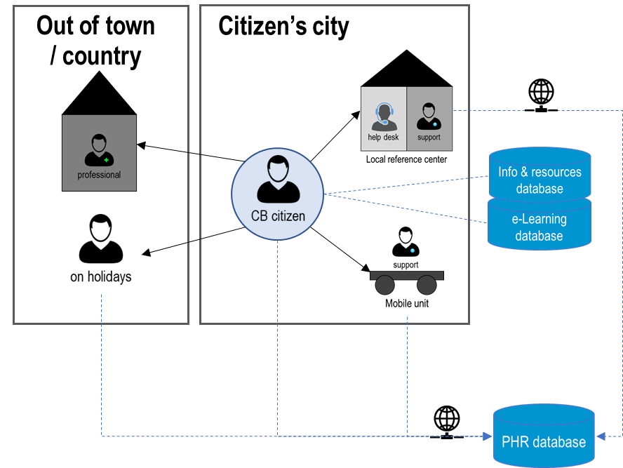

Target: 150 pers
per pilot
User Category #3
PHR owner who interacts with:
Local (onsite and/or mobile) support expert
5
5
5
PHR web
platform (D4.1.2)
5
PHR database
5
Through: Local Center’s and Mobile Units

Slide 5
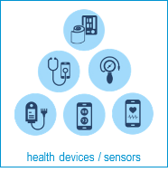

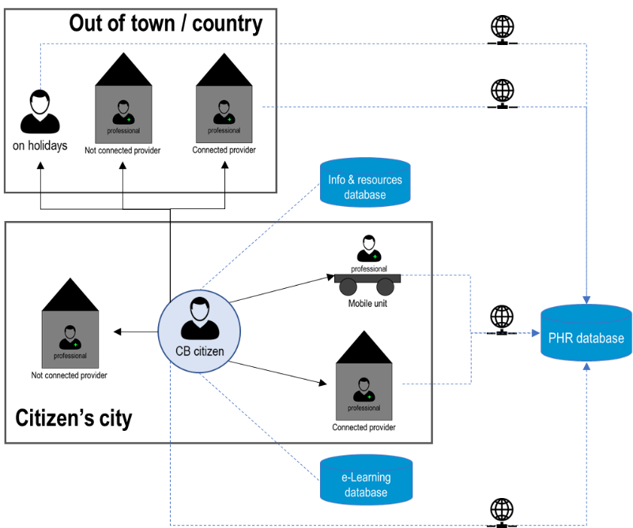
Target: 300 pers
per pilot
User Category #4
PHR owner who interacts with:
Local (onsite or mobile) connected service provider(s) [and thus be given a telemonitoring set]
Abroad (onsite only) connected service provider(s)
D5.x.1
PHR mobile app
for pros (D5.1.1)
8
8
PHR database
8
D5.x.2
8
8
8
8
7
PHR mobile app
for citizens (D5.2.2)
7
Through: Local onsite and mobile kits

Slide 6
Target: no limit
User Category #5
PHR owner who interacts with:
Local Connected Service Provider in Ohrid
e-Prescription &
e-Referral (D4.2.4)
9
9
9
PHR database
Through: Local onsite kits

