Slide 1

Overview of the Cross4all integrated system
offer information on services, including information about access and accessibility
support the operation of a volunteer programme
offer access to resources for professionals
offer access to resources for citizens
offer info about & access to ePHR, eLearning, e-Prescription and e-Referral
offer access to eLearning for citizens (health & digital health literacy)
allow citizens to create and maintain their own ePHRs (optionally, with the support of the staff of the centers)
allow citizens to import data to their own ePHR, automatically from connected/supported devices
allow citizens to share data of their ePHRs, in a user-friendly manner, with health professionals across the borders
allow automatic (i.e., easy and free of error) importing of data from third party systems that it interfaces with (e.g., existing healthcare electronic systems of various healthcare authorities, including national prescription systems, hospital electronic systems, private telecare services, etc.)

Slide 2



Overview of the Cross4all integrated system
offer access to eLearning for citizens (health & digital health literacy)
e-Learning
web platform (D4.2.3)
allow citizens to create and maintain their own ePHRs (optionally, with the support of the staff of the centers)
allow citizens to import data to their own ePHR, automatically from connected/supported devices
allow citizens to share data of their ePHRs, in a user-friendly manner, with health professionals across the borders
offer information on services, including information about access and accessibility
support the operation of a volunteer programme
offer access to resources for professionals
offer access to resources for citizens
offer info about & access to ePHR, eLearning, e-Prescription and e-Referral
PHR
web platform (D4.1.2)
PHR mobile app
for citizens (D5.2.2)
allow automatic (i.e., easy and free of error) importing of data from third party systems that it interfaces with (e.g., existing healthcare electronic systems of various healthcare authorities, including national prescription systems, hospital electronic systems, private telecare services, etc.)
Cross-border
web portal (D4.3.1)
CB mobile app
for citizens (D5.3.3)
e-Prescription &
e-Referral (D4.2.4)
PHR mobile app
for pros (D5.1.1)

Slide 3

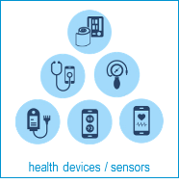







e-Prescription &
e-Referral (D4.2.4)
D5.x.1
9
Cross-border
web portal (D4.3.1)
PHR mobile app
for pros (D5.1.1)
8
Info & resources database
1
6
5
CB mobile app
for citizens (D5.3.3)
PHR web
platform (D4.1.2)
2
4
e-Learning
database
D5.x.2
PHR database
3
e-Learning
web platform (D4.2.3)
7
PHR mobile app
for citizens (D5.2.2)

Slide 4
1. A Visitor (citizen or health professional or volunteer) can access through his own device or trough a public Cross4all infokiosk (see D4.x.5) the Public web portal to:
  find information on healthcare services, including information about access and accessibility (see D3.x.2), including maps, inspections data, transportation info, etc.
  get involved into the volunteer programme (view or announce or reply to request/offers for support services, etc.)
  find educational resources (see D3.x.4 and D3.x.5)
  find information on survey results (see D3.x.1) and other key project outcomes (e.g., D3.x.3, D2.6.2 and D6.x.3)
  find / request information / guidance about existing tools, services and resources (Help desk)
2. A Visitor (citizen or volunteer) may also download on his/her own mobile device and use the
CB mobile app for citizens and access on the move information and geolocated guidance:
  search for information on healthcare services, including nearby options
  acquire personalized and georeferenced guidance and accessibility information (throughout their journeys across the CB area)
  make his own travel plan
  submit inquires to and receive replies from the Help Desk (see D4.x.5)
  receive and send notifications related to the volunteer programme
  receive mass notifications / alerts related to health tourists
(D4.3.1)
Cross-border
web portal (D4.3.1)
Info & resources database
1
(D5.3.3)
CB mobile app
for citizens (D5.3.3)
2

Slide 5
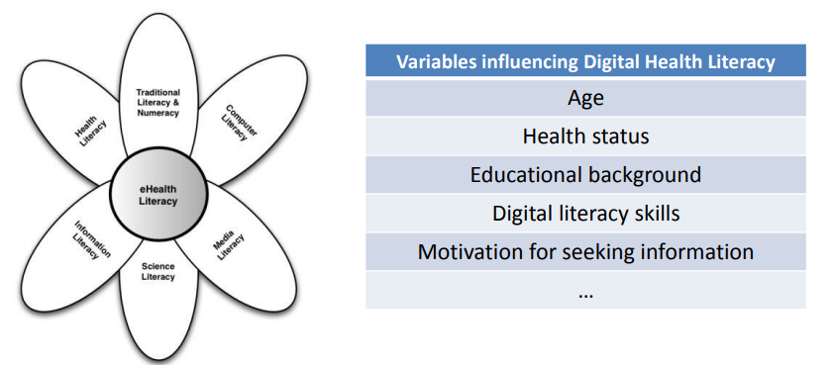
3. A Visitor (citizen) may also be informed of the existence of a special eLearning platform
and be redirected to it in order to:
  register to special courses related to health literacy (the ability to obtain, read, understand, and use healthcare information in order to make appropriate health decisions and follow instructions for treatment, e.g., for addressing or solving various health problems, such as NCDs, etc.
  register to special courses related to digital health l health literacy (set of skills, knowledge, and attitudes that a person needs in order to (a) seek, find, and appraise health information and services from electronic sources, and (b) to find, select and make effective use of available tools (PHRs, devices, mobile apps, etc.)
(D4.2.3)
3
e-Learning
web platform (D4.2.3)

Slide 6
Once a Visitor decides to create his own PHR on Cross4all cloud, he/she becomes a PHR owner.
4. A PHR owner (citizen) can use the PHR web platform through his/her own device or a public Cross4all infokiosk
(see D4.x.5) to:
  store/view his/her own health profile and history
  store/view his/her own medication plan
  store/view his/her visits to health service providers and upload related medical documents (per visit)
  store/view his/her vital signals collected with his/her own (not connected) medical devices
  find, select and export data of his/her PHR in various formats
  find, select and share data of his/her PHR in various ways, e.g., with health professional within or across the boarders
(D4.1.2)
6
5
PHR web
platform (D4.1.2)
4
5. A PHR owner (citizen) may visit any Local support expert
(see D6.x.1) to:
  receive assistance for learning how to use / manage his /her own PHR
  receive assistance for initiating/configuring his/her own PHR
  receive service for digitizing paper-based records of his/her and/or grant access for uploading them appropriately on his/her own PHR on his/her behalf
  Be informed of, and approve or not, data entries by the support staff
(D6.x.1)
PHR database
(D4.1.2)

Slide 7
6. A PHR owner (citizen) may visit any Health service professional (who has no access to a connected third-party system) and:
  grant him/her access (temporary or not) to view parts or whole of his PHR, using the PHR web platform
  grant him/her access (visit-related) to add / upload data to his/her own PHR, using the PHR web platform
  Be informed of data viewed by the professional
  Be informed of, and approve or not, data edited / entered by the professional
(D4.1.2)
6
  Note:
  Upon granting of access user can choose:
  to auto-persist changes from other or
  require his/her own verification in order to persist proposed changes
5
PHR web
platform (D4.1.2)
4
PHR database

Slide 8

types of information & data to be held
Data (not files) in PHR database must automatically stored in all languages
user data
general data &
characteristics
health profile
(automatically extracted and/or from user input)
data from health professionals
data from the user (automated of user entry)
general data
(name, surname, national insurance number, email, etc.)
current conditions / diseases / allergies
measurements & inspection results
measurements
(e.g., vital signs, weight, etc.)
characteristic
(sex, age,
blood type, etc.)
current plan
lab & imaging results
symptoms
reports
(e.g., dizziness)
family
history
medical history
(hospitalizations, surgeries, therapies, immunizations, etc.)
intervention reports & data
(e.g., surgical)
actions reports
(e.g., taking pill)
routine reports
(sleep, diet,
exercise, etc.)
user profile
(user ID, password,
preferences, etc.)
life style
(diet, sleep,
exercise, etc.)
diagnosis
data that can also be generated / imported automatically though devices / apps / systems
instructions / plan
scheduled visits
disabilities
risk factors
prescriptions
questionnaire based-reports
referrals

Slide 9

7. A PHR owner (citizen) download on his/her own mobile device
the PHR mobile app for citizens or use a mobile set of devices provided by Cross4all (see D5.x.2) to:
  store new data to and view his/her own PHR
  schedule and receive notifications related to his medical plan, doctor visits, etc.
  store/view his/her vital signals collected with
  his/her own or provided (connected / supported) health devices / sensors (see D5.x.2)
  find, select and share data of his/her PHR, e.g., with health professional within or across the boarders
(D5.2.2)
(D5.x.2)
measurements
(e.g., vital signs, weight, etc.)
routine reports
(sleep, diet,
exercise, etc.)
symptoms
reports
(e.g., dizziness)
scheduled visits
D5.x.2
PHR database
actions reports
(e.g., taking pill)
questionnaire based-reports
7
PHR mobile app
for citizens (D5.2.2)

Slide 10
8. A PHR owner (citizen) may visit any Health service professional who has access to a Connected third-party system (see D5.1.1) and:
  [precondition: has granted the professional access rights (temporary or not) to view parts or whole of his/her PHR data]
  view parts or whole of the patient’s PHR data through his/her PHR mobile app for pros
  [precondition: has granted the professional access rights to add / upload data (visit-related) to his/her PHR data]
  add / upload data (visit-related) to the patient’s PHR through his / her PHR mobile app for pros
  [precondition: has granted the professional access rights to add / upload data (visit-related) to his/her PHR data]
  add vital signals to the patients PHR (visit-related), which are collected through his/her health devices/ sensors connected to his/her PHR mobile app for pros (see D5.x.1)
D5.x.1
(D5.1.1)
PHR mobile app
for pros (D5.1.1)
8
(D5.x.1)
PHR database
measurements & inspection results
instructions / plans
diagnosis
schedule visits

Slide 11
e-Prescription &
e-Referral (D4.2.4)
8. A PHR owner (citizen) may visit any Health service professional who has access to a Connected third-party system (see D4.2.4) and:
  [precondition: has granted the professional access rights (temporary or not) to view parts or whole of his/her PHR data]
  view parts or whole of the patient’s PHR data, through his / her e-Prescription & e-Referral systems
  [precondition: has granted the professional access rights (temporary or not) to add / upload new data to his/her PHR data]
  add / upload data to the patient’s PHR through his/her e-Prescription & e-Referral systems
9
(D4.2.4)
PHR database

