Slide 1
PHR mobile app for Pros and PHR web platform Presenter: Vassilis Kilintzis
Project Meeting, {05-06} {September} {2019}
Venue: Metropol Lake Resort

Slide 2
Registration
Click to visit the Registration Page

Slide 3
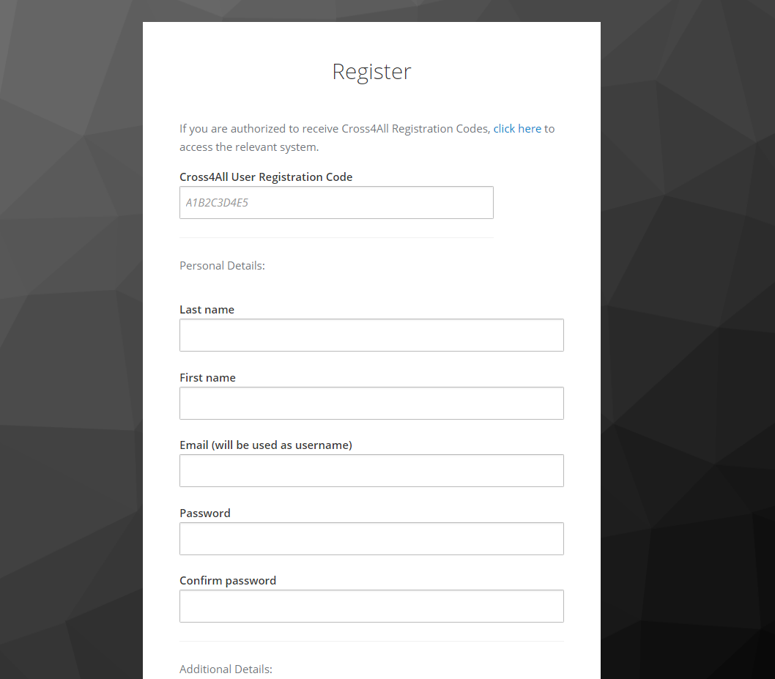
Registration
Only authorized users can register to the Cross4All platform. To receive
Cross4All Registration Codes, click on the link provided in the registration page. Click to request registration code
Upon receipt of the registration code enter the registration code received by email in the field.
Complete the details on the form.
Note that the email and password provided in the registration form will be used as credentials in the Cross4all mobile application.

Slide 4
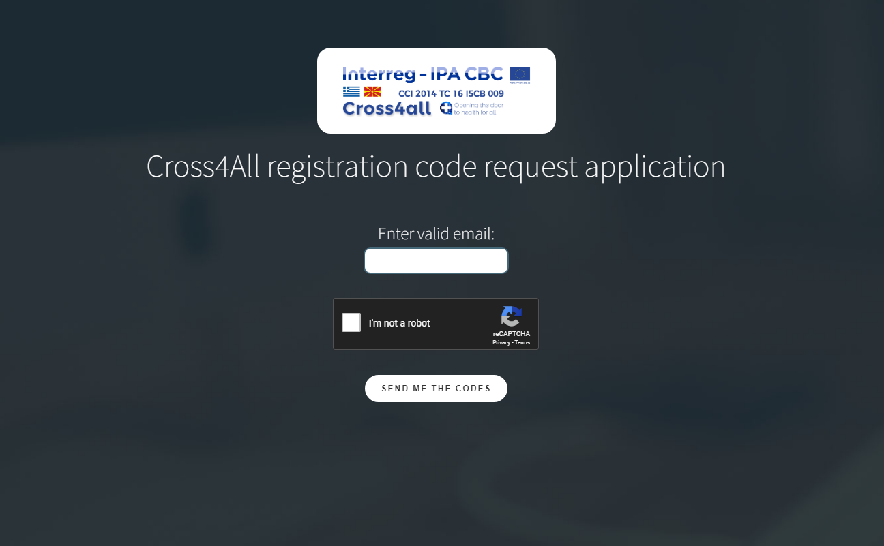
Registration
Enter a valid email and click on “Send me the codes” button. If you are an authorized Cross4all user you will receive an email with valid registration codes.

Slide 5
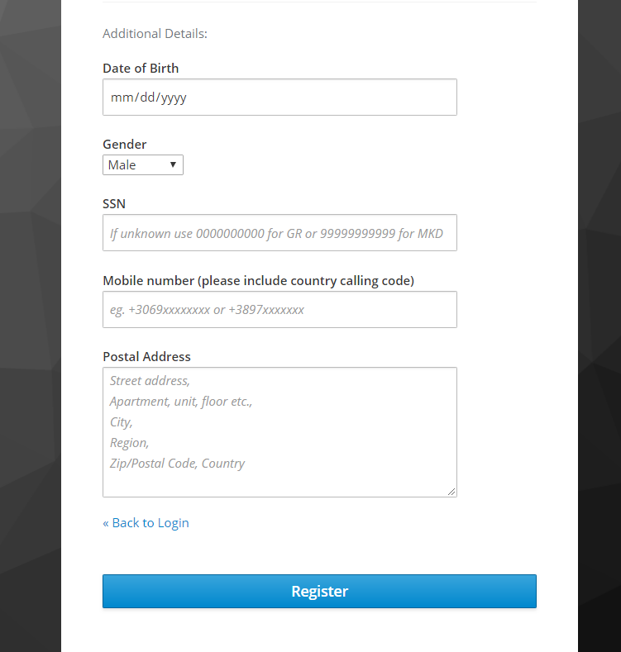
Registration
Upon completion of the form click on “Register” button to complete the registration process. If successful you will be prompted to the PHR web interface.

Slide 6
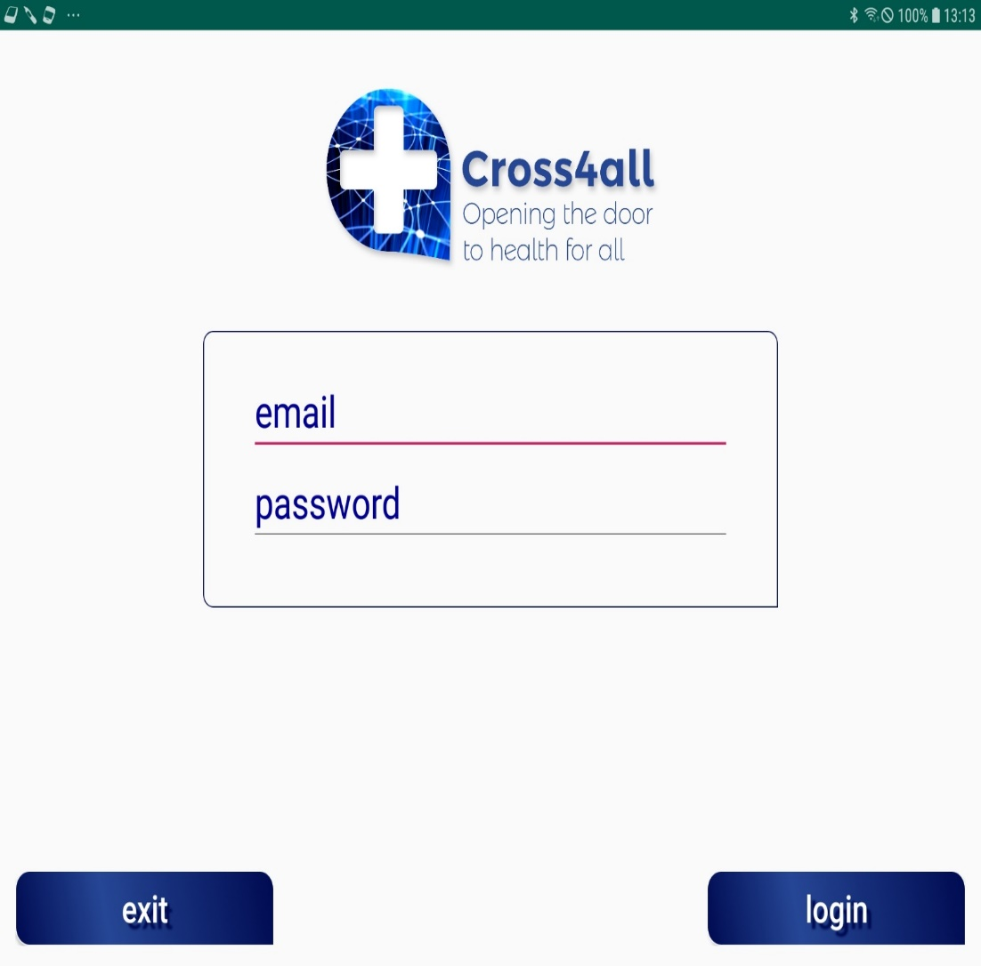
Logging in the Cross4All Mobile Application
To login in the Cross4all platform the email and password which were used during the registration process are required.
Click exit button to exit application
Click on login button to login

Slide 7
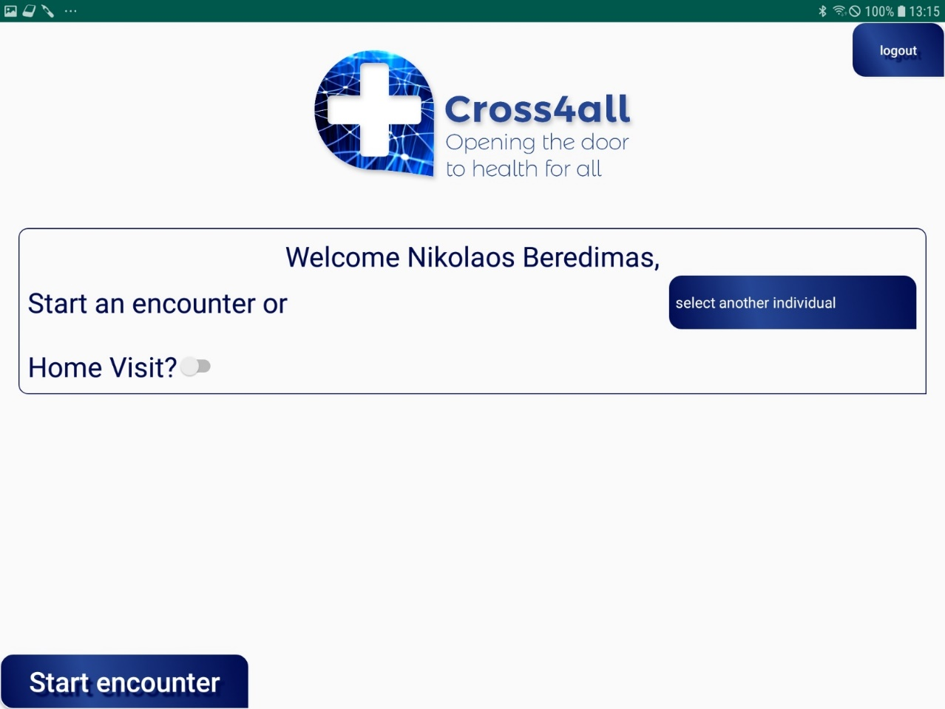
Logging in the Cross4All Mobile Application
Upon successful login the user can select to start an encounter (session) for himself OR for another patient.
To start an encounter for the user logged in just click ton the “Start encounter” button.
To start an encounter for another individual first select the name of the person from the dropdown list (“Select another individual” button )and then click on the “Start encounter” button.
In the case of Home visit enable the “Home Visit” toggle button.

Slide 8
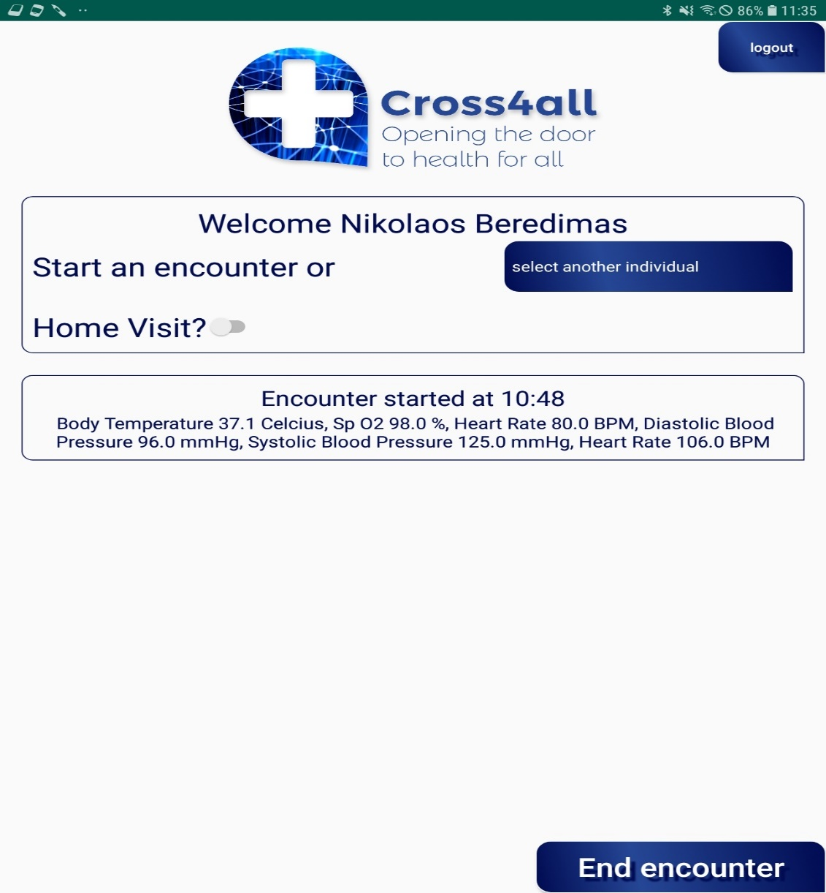
Logging in the Cross4All Mobile Application
To log out click on the “logout” button.
The encounter has started for the user logged in.
User can view current measurement results.
To end an encounter click on the “End encounter” button.

Slide 9
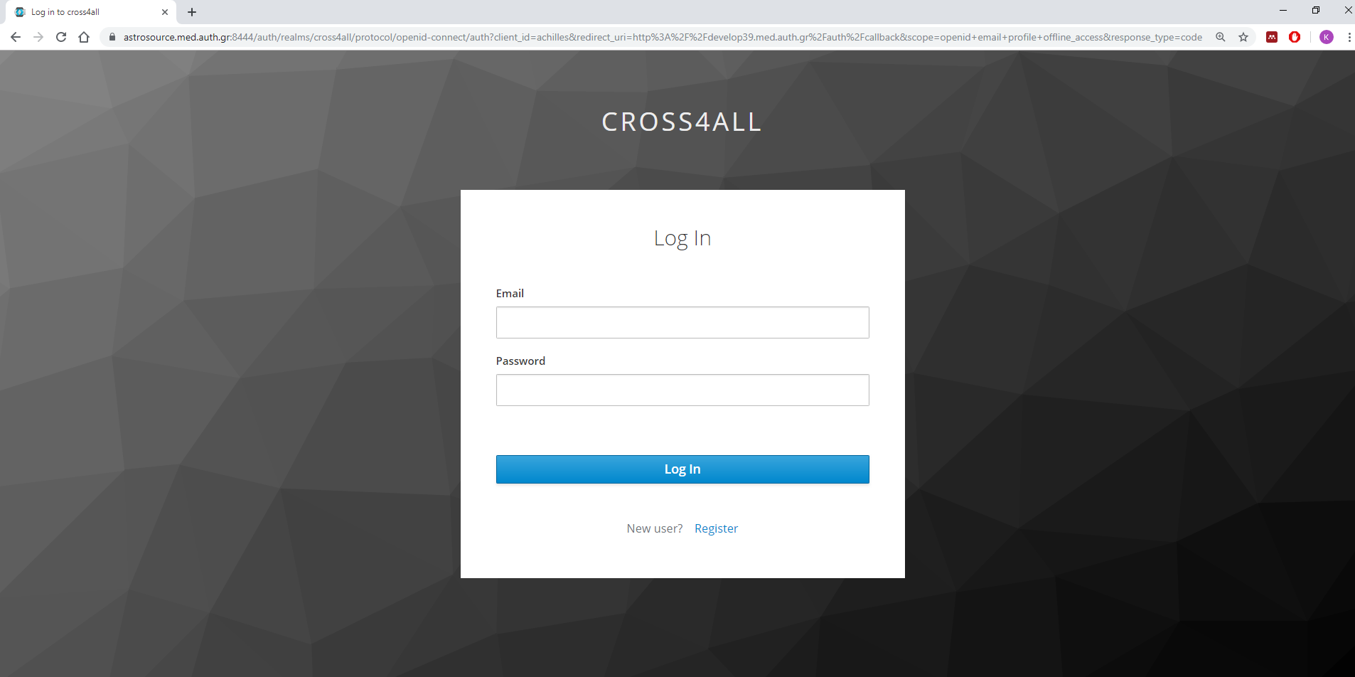
Logging in the Cross4all PHR web platform
To log in the PHR platform the user email and password are required. Clicking on the Log in button will redirect the user to the PHR Homepage.
Click to visit the Cross4all PHR web platform

Slide 10
PHR Homepage
Most recent results can be viewed in the home page. By clicking on the label of the measurement you can view more results.
A list of the encounters on a specific date can be viewed when using the calendar. Clicking on the encounter will redirect the user to a page with all encounter details.

Slide 11
PHR Homepage
User can access the medication and diagnosis pages by clicking on the relevant buttons.

Slide 12
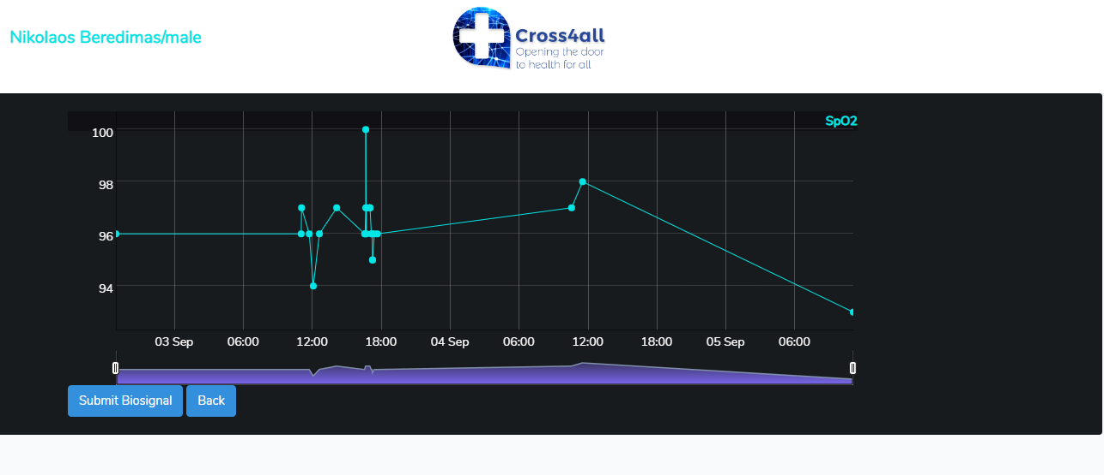
Viewing measurements
User can add a measurement manually by clicking on the Submit Biosignal button.

Slide 13
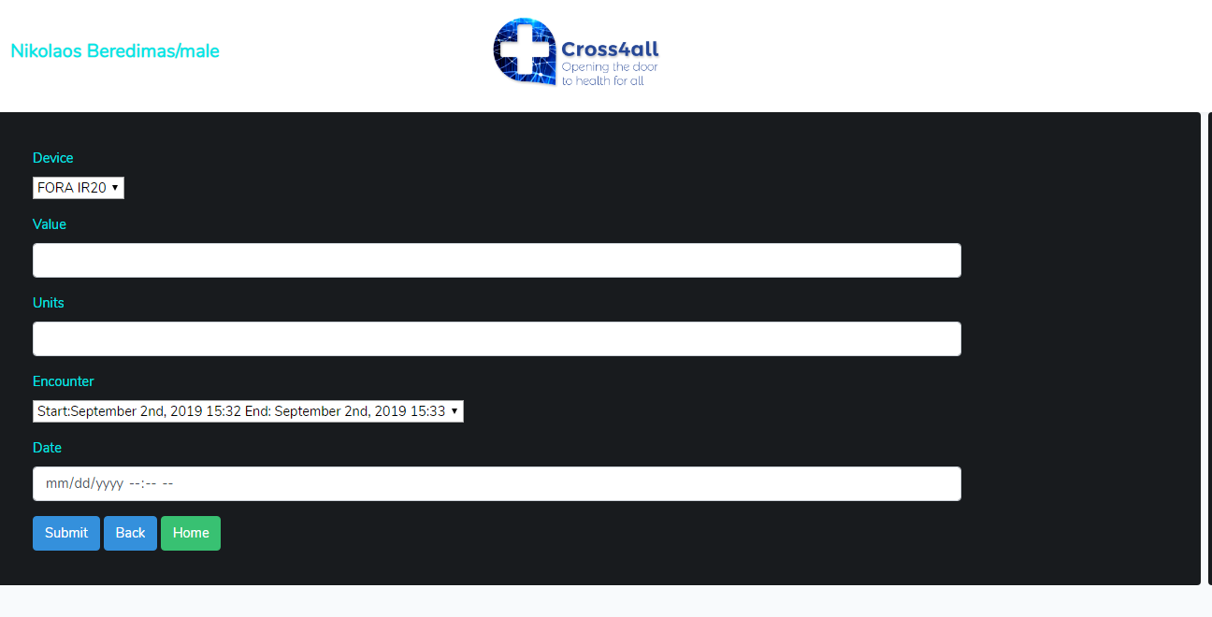
Inserting measurements manually

Slide 14
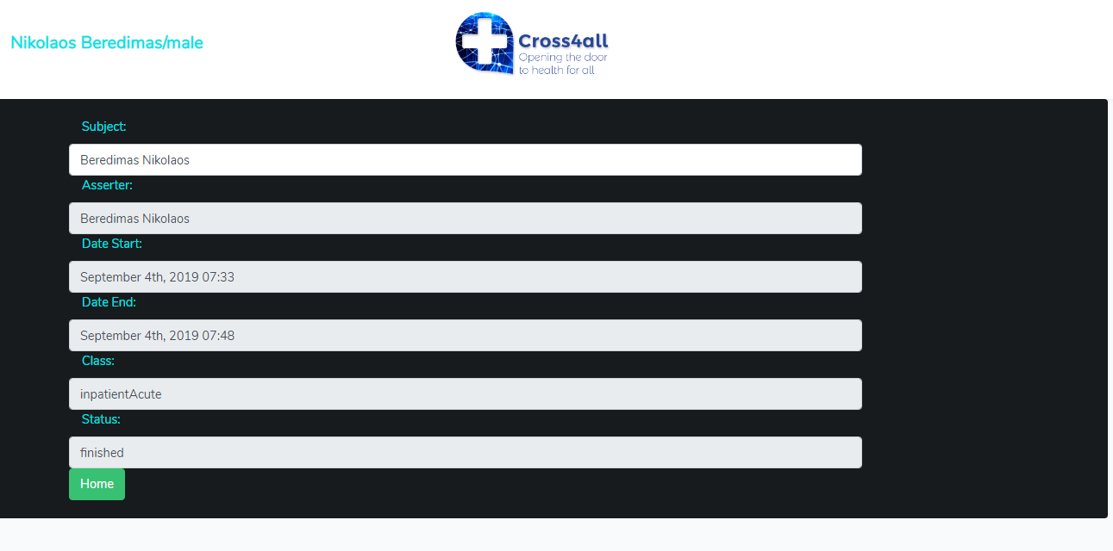
Encounter details

Slide 15
Medication details

Slide 16
Adding prescription

Slide 17
Diagnosis page
User can select a diagnosis from a dropdown list. The field is searchable by typing a diagnosis or icd10 code.
User submits the diagnosis by clicking on the “submit” button

Slide 18
Diagnosis page
User can add a new diagnosis by clicking on the “Add diagnosis” button.

