Slide 1
Progress and plans at local level
Presentation of PP2 Faculty of information and communication technology – UKLO -Bitola
4^{rth}Project Meeting, 5-6 September 2019
Host: Ohrid municipalyty – R.of N. Macedonia (PB4)
Venue: Metropol Hotel – Ohrid
Presenter: Snezana Savoska

Slide 2
Contents of the Presentation
The status of their staff recruitments
The status of their Tenders
Their work progress per deliverable, specifying problems and issues
The status of their expenditures paid out so far
The status of their expenditures verified until so far
The expected expenditures paid out until 31.12.2019
The status of activities performed and/or planned for the dissemination / publicity of the Project

Slide 3
Status of the activities – PB2
Status of staff recruitment
5 programmers hired on D.5.2.2 (May and August 2019)
Tenders procedures status
Finished procedure for e-Prescription and e-Referral system – Contract signed - (ongoing)
Finished procedure for WCAG2.0 and Impact Assessment Study – Contract signed - (waiting for start)
Procedure for 3 days seminars is not finished (tender was nor successful 2 times), new procedure will be launched at October 2019

Slide 4
Work progress in deliverables - 1
D423 –Finished specification for the content format of e-learning platform for e-health and digital health literacy
D522 –Finished system analysis procedures; launching procedure for engagement of 8 staff for D522. Engagement of 5 people for staff cost
Contracts for services of translation from Mk to En and GR (D423, D424, D522, D623, D624) signed
Contract for e-Prescription and e-Referral (3.2019) – D.424 signed
Finished procurement procedure for D522 mobile sets for vital signs measurements (7.2019), contract signed, equipment is given to D522 staff;
Finished procurement procedure for WCAG2.0 compliance services of digital assets (D423, D424, D522) and final assessment report of influence of the project in the cross border area – R. Of N. Macedonia site –D623 (6.2019)
First version of First Strategy and action plan D3.2.3 sent to PB4 and PB

Slide 5
The status of PB2 expenditures paid out so far
External expertise and service - Event in Bitola 585 euro
Equipment – 4 sets for measurement of vital signs 7.760 euro
Travel and accommodation (2 trips in Thessaloniki) 1.003 euro
Staff cost (2.2018 – 4.2019) 24.383 euro
TOTAL expenditure 33.747.89 euro
____________________________________________________
LB1- EU funds 30.412.55 euro
UKLO refinancing 3.336 euro
TOTAL received 33.748.55 euro
_____________________________________________________
FLC is ongoing…

Slide 6
The expected expenditures paid out until 31.12.2019

Slide 7
The status of activities performed and/or planned for the dissemination / publicity of the Project
D3.2.5 - Organization of 1 three-day seminar – tender will be launched again at October 2019, planed after the first application of D522 and D423 (e-learning for e-health and digital literacy, project web site D224) and D424 (e-prescription and e-referral) will have first version ready
Organization of a one-day Public Project Event (Closing Project Conference) depends on the finished project activities
During this period of time, we prepared and submitted the papers:
3rd international conference of e-education, e-business and e-technology, 2-4.8.2019, “Learning Management Systems as Platforms for Increasing the Digital and Health Literacy” (Natasha Blazheska-Tabakovska, Blagoj Ristevski, Snezana Savoska and Andrijana Bocevska)
Computer and Communications Engineering, Vol. 13, No. 2/2019 Workshop on Information Security 2019, 9th Balkan Conference in Informatics, “Design of Cross Border Healthcare Integrated System and its Privacy and Security Issues (Savoska Snezana, Jolevski Ilija, Ristevski Blagoj, Blazeska-Tabakovska Natasha, Bocevska Andrijana, Jakimovski Boro, Chorbev Ivan and Vassilis Kilintzis). The conference will be held 26-28.9.2019
Submitted papers for ICT innovation 2019 in Ohrid “Towards Integration Exposome Data and Personal Health Records in the Age of IoT” (Savoska, Ristevski, Tabakovksa, Jolevski) – 17-19 October 2019

Slide 8
e-Learning web platform (D4.2.3)
offer access to eLearning for citizens (health & digital health literacy)
A Visitor (citizen) can be informed of the existence of a special eLearning platform and be redirected to it in order to:
register to special courses related to health literacy (the ability to obtain, read, understand, and use healthcare information in order to make appropriate health decisions and follow instructions for treatment, e.g., for addressing or solving various health problems.
register to special courses related to digital health and e-health literacy (set of skills, knowledge, and attitudes that a person needs in order to (a) seek, find, and appraise health information and services from electronic sources, and (b) to find, select and make effective use of available tools (PHRs, devices, mobile apps, etc.)

Slide 9
e-learning team activities:
Month | responsible | Planed activity | Finished activity | Notes
March -April | e-learning team | Technical specification for formats of learning courses and contents intended to improve the digital and health literacy among children, people with disability and elderly people (Technical specification is made with PB4 and PB6 and sent to PB3 and LB1) | Yes
 |  | Preparation e-learning platform for posting courses (we still are waiting for content (from PB3) – main menu posted for internal use (Procurement procedure NCDP – PB3) | Yes
 | e-learning team
May 2019 – Sep 2019 | e-learning team | Testing ATutor for some examples – materials for WCAG2.0 for internal use: Defining different course participants’ group (people with impaired vision, impaired hearing, elderly people...). Тhe content will be adapted for each group: If it is about children, alternative content can be produced that will be written in a way that is easy to understand for children, will contain more pictures, audio and videos that are interesting and age-appropriate. In the case of the elderly, the content can be capitalized and navigation can be easy. In the case of people with visual impairments, the textual content can be displayed as audio content, so that those who have problems with reading the textual content will be able to hear it. | Yes

Slide 10
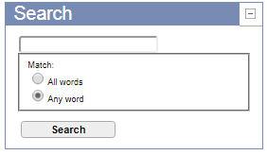
E-learning for e-health - views
enabling communication of course attendees via email or forums, content search

Slide 11
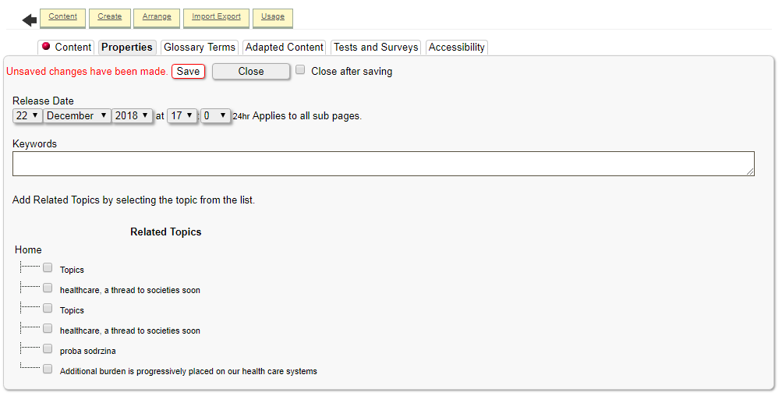
setting parameters for easier tracking of content from different attendances’ groups
defining course properties

Slide 12
Additional reading recourses

Slide 13
PHR - mobile app for citizens (D5.2.2)
allow citizens to:
create and maintain their own ePHRs (optionally, with the support of the staff of the centres)
import data to their own ePHR, automatically from connected/supported devices
share data of their ePHRs, in a user-friendly manner, with health professionals across the borders
PHR mobile app for citizens or use a mobile set of devices provided by Cross4all (see D5.x.2) to:
store new data to and view his/her own PHR, receive notifications related to his medical plan, doctor visits, store/view vital signals collected with health devices / sensors (see D5.x.2), share data with professional within or across the boarders
Equipment – we have it from 17.7.2019
Hiring staff working on D522 - 5 staff.
Finished: Provision, installation and maintenance of 4 complete sets of equipment (tablet/mobile, wireless multi sensor for vital sign recording (heart rate, heart pressure, breath rating, body temperature, glucometer, etc.) for development testing the PHR mobile app for citizens

Slide 14
PHR - mobile app for citizens (D5.2.2)
Month | responsible | Planed activity | Finished activity | Notes
March- May 2019 | Ilija Jolevski | Working on scenarios for mobile applications, mock up, procurement procedure technical documentation, hiring procedure for D522 | Yes
June-August 2019 | Ilija Jolevski | Testing data transfer between cloud repository of the equipment vendor and local computer (or cross4all cloud) Testing mobile equipment for data transferring possibilities Testing data transfer between cloud repository of the equipment vendor and local computer (or cross4all cloud) Bluetooth device comparation, BLE standards, Android FIT standards, web research. Device selection. Open source solution research Researches for data availability of the vendors’ cloud systems Preparing Technical specifications for tablets or mobiles Preparing Technical specifications for sets of health devices/sensors Mobile app user interface Designing data flow diagrams for mobile applications and solving issues with security and privacy of the user data. | Yes, Ongoing

Slide 15
PHR - mobile app for citizens (D5.2.2)-2
Month | responsible | Planed activity | Finished activity | Notes
June-August 2019 | Ilija Jolevski | Android library creation for communication with BLE devices (measurement devices) Integration of the app with te devices Security login layer with Keycloak server development Data storage design in the mobile app Cloud use-cases defined and developed Designing data flow diagrams for mobile applications and solving issues with security and privacy of the user data. | Yes, Ongoing

Slide 16
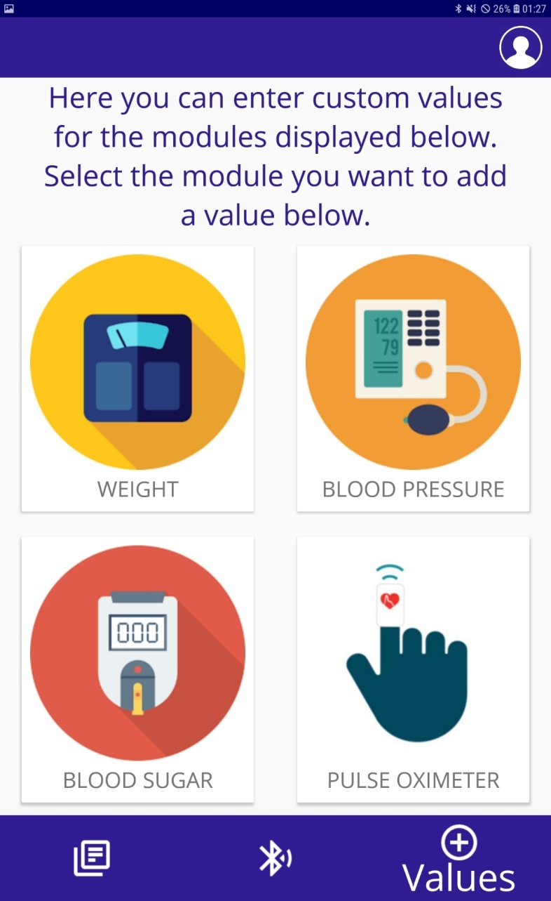
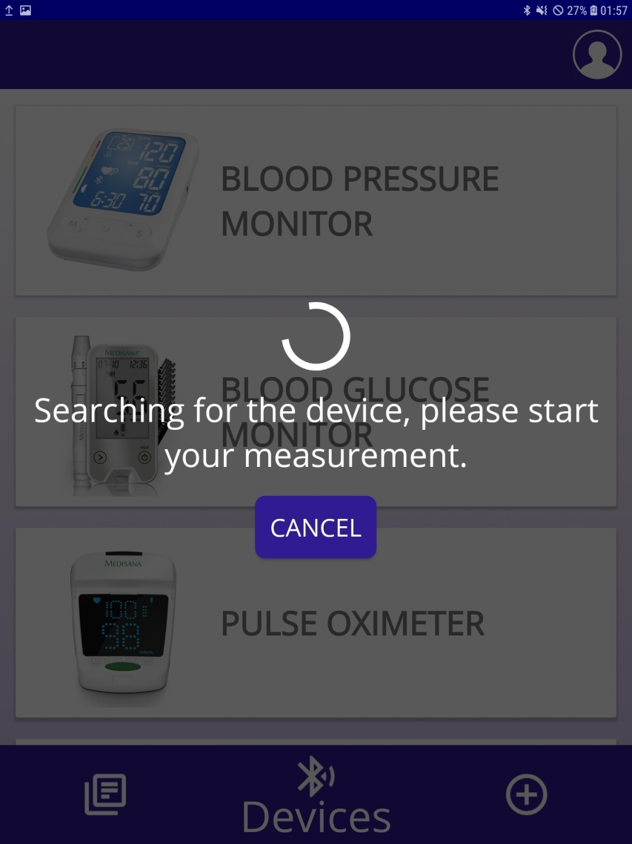
Screens from mobile app for citizens – we working….

Slide 17
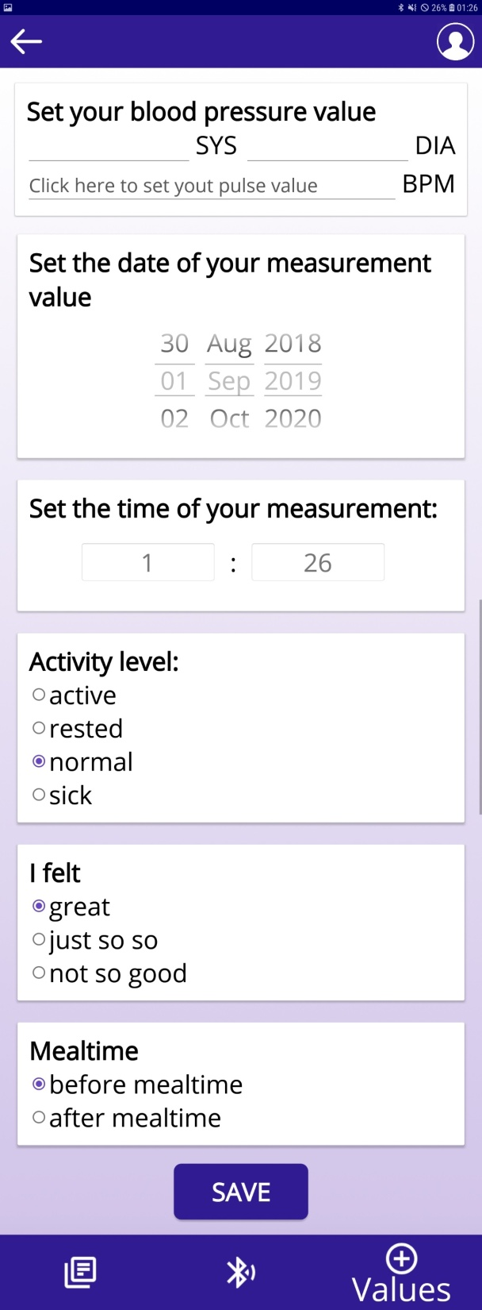
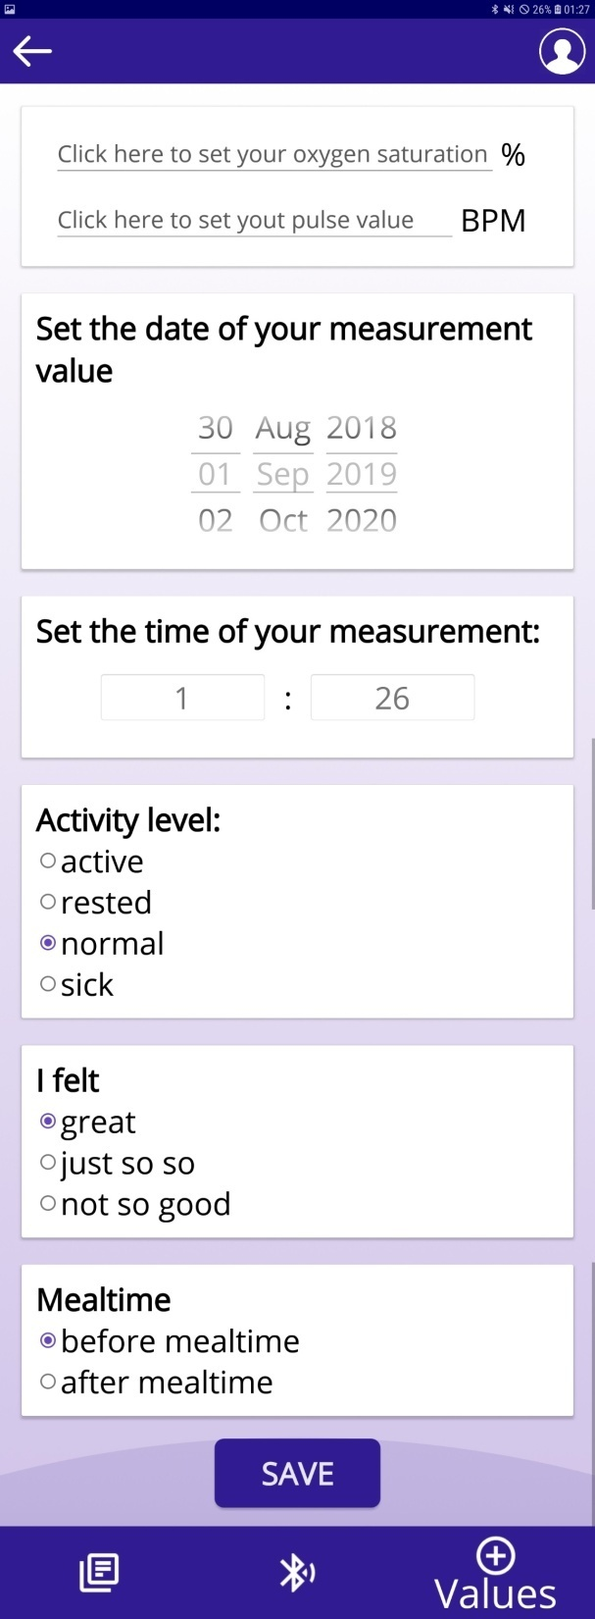
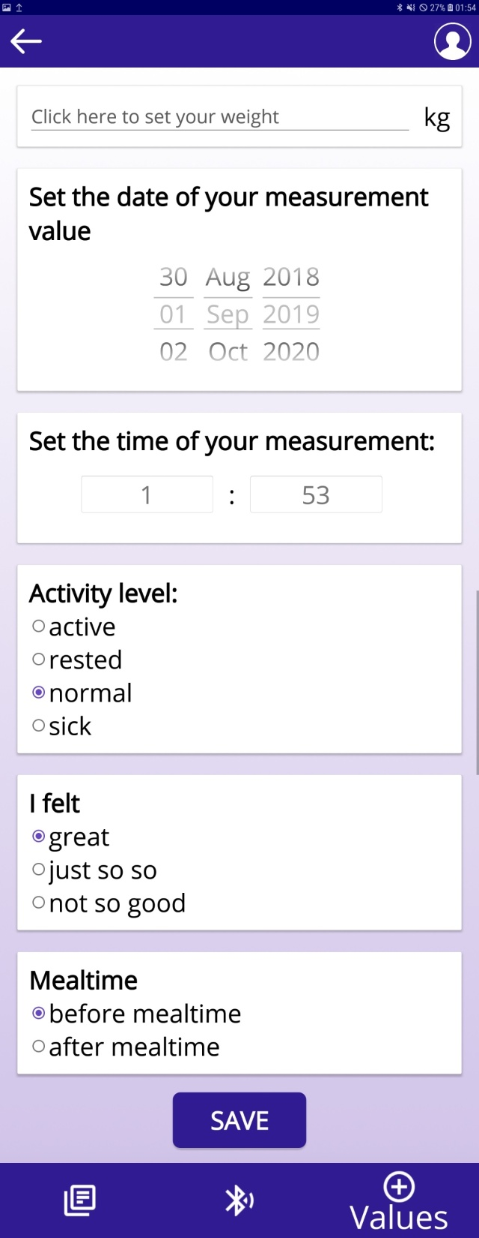

Slide 18
e-Prescription & e-Referral (D4.2.4)
allow automatic (i.e., easy and free of error) importing of data from third party systems that it interfaces with (e.g., existing healthcare electronic systems of various healthcare authorities, including national prescription systems, hospital electronic systems, private telecare services, etc.)
Procurement procedure for e-Prescription & e-Referral systems are finished, Contract is signed. In preparation...

Slide 19
Month | responsible | Planed activity | Finished activity | Notes
March – May 2019 | Project manager, Assessment team | Finished procurement procedure for WCAG2.0 Accessibility and impact assessment study, signed contract | Yes
 | Assessment team for D522 | Procurement procedure for 4 complete sets of equipment (tablet/mobile, wireless multi sensor for vital sign recording) (heart rate, heart pressure, breath rating, body temperature, glucometer, etc.) , Signing contract, payment, Available sets from 17 July 2019 | Yes
June-August 2019 | Project manager, D522 team | Hiring staff for D522 - 5 staff members | Yes
September - December 2019 | Project manager, D522, D424, D423 teams | Working on products’ design, connectivity with C4A cloud, working onWCAG2.0 standard implementation in these digital assets, coordination with partners and contractors, Procurement procedure for tenders for 3-days seminar, equipment and one day event in Skopje, Improved version of Strategy and Action plan for Mk part cross border part

Slide 20
Problems, Risks and issues to be considered
Waiting for finishing procurement procedure of PB3 (for material for e-Learning on health and digital health literacy)
Signed contracts for the planed period. Latter activities can be problematic because of availability of experts of External expertise and services
Question: When we can expect the material for e-learning for digital literacy for e-health for e-learning platform?
-They have to be some base for our three days workshop?
- When we have to planning this activity?
- Do we expect some project prolongation? Can we catch the planned dynamic?
Maybe some contract have to be prolonged with Annexes?
Thanks for your attention!

