Slide 1

Cross4all
A few words about our project

Slide 2









Project identification & Consortium
Partners
from Greece
CALL FOR PROPOSALS
Cross-border initiative for integrated health and social services promoting safe ageing, early prevention and independent living for all
Aristotle University of Thessaloniki
Department of Medicine
www1.med.auth.gr/depts/lomi/
National Confederation of Disabled People Branch of Northern Greece
www.esamea.gr
Municipality of Neapoli-Sykies
www.dimosneapolis-sykeon.gr
PROGRAMME
INTERREG IPA Cross Border Cooperation Programme
CCI 2014 TC 16 I5CB 009
PRIORITY AXIS
1
Development and Support of Local Economy
Partners from
North Macedonia
THEMATIC PRIORITY
University of St. Kliment Ohridski - Bitola
Faculty of ICT
www.fikt.uklo.edu.mk
Municipality of Ohrid
www.ohrid.gov.mk
Institute for prevention, treatment & rehabilitation
of cardiovascular diseases St. Stefan Ohrid
www.bcentermaritza.weebly.com
1a
Promoting social inclusion, combating poverty
and any discrimination
SPECIFIC OBJECTIVE
Improvement of preventive health care and social services of children and elderly population
1.2

Slide 3
Project identification & Consortium
SO
1.2
Partners
from Greece
PROJECT TITLE
1st CALL FOR PROJECT PROPOSALS (SO1.2)
Aristotle University of Thessaloniki
Department of Medicine
www1.med.auth.gr/depts/lomi/
National Confederation of Disabled People Branch of Northern Greece
www.esamea.gr
Municipality of Neapoli-Sykies
www.dimosneapolis-sykeon.gr
MAX DURATION
MAX BUDGET
24 months
€1.500.000,00
MAX SIZE OF PARTNERSHIPS
6 beneficiaries
Partners from
North Macedonia
RESULTS INDICATORS
University of St. Kliment Ohridski - Bitola
Faculty of ICT
www.fikt.uklo.edu.mk
Municipality of Ohrid
www.ohrid.gov.mk
Institute for prevention, treatment & rehabilitation
of cardiovascular diseases St. Stefan Ohrid
www.bcentermaritza.weebly.com
Population having access to health services
Population having access to social services
OUTPUT INDICATORS
Population covered by improved health services
Population covered by improved social services

Slide 4








Budget distribution
1.145.290,00
Institute
St. Stefan Ohrid
Aristotle University
of Thessaloniki
Municipality of
Ohrid
National Confederation
of Disabled People
of Greece
University of
St. Kliment Ohridski - Bitola
Municipality of
Neapoli-Sykies
24 months

Slide 5
The project’s concept

Slide 6



Budget distribution
Before visiting a dietician, how do you prepare yourself?

Slide 7

Budget distribution
When your kid’s tooth hurts, where would you go?

Slide 8
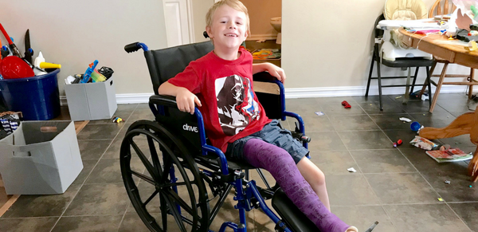
Budget distribution
And what if at the same time…
his leg is broken?

Slide 9
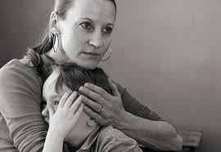
Budget distribution
Now put yourselves in her shoes…

Slide 10

Do you think that there are appropriate provisions in place for providing access to health services for persons with disability on an equal base with the rest of the citizens?
_{NA}
_{DK}
_{YES}
_{NO}
4%
4%
38%
54%
Telephone survey with 1.406 persons living across the Greek part o the programme area (July 2019)

Slide 11
Which of the following obstacles faced by people with disabilities / chronic illnesses in receiving the health / care services they need most do you consider as most frequent? (multiple choice)
Accessibility
(of buildings, infrastructure, medical equipment, etc.)
69%
Availability
(lack of services needed in our area)
44%
Cost
(high in relation to that of the general public)
43%
Quality of service
(low in relation to that for the general public)
40%
Access to information
(low of access / availability of sources of information)
32%

Slide 12
To meet your health / care needs, do you feel the need to move out of your place of residence?
For what reason?
Cost
Accessibility
_{3%}
1%
Quality
_{5%}
10%
_{DK / NA}
_{1%}
_{26%}
12%
Availability
_{80%}
85%
_{NO}
_{72%}
61%
_{YES}
_{27%}
38%

Slide 13
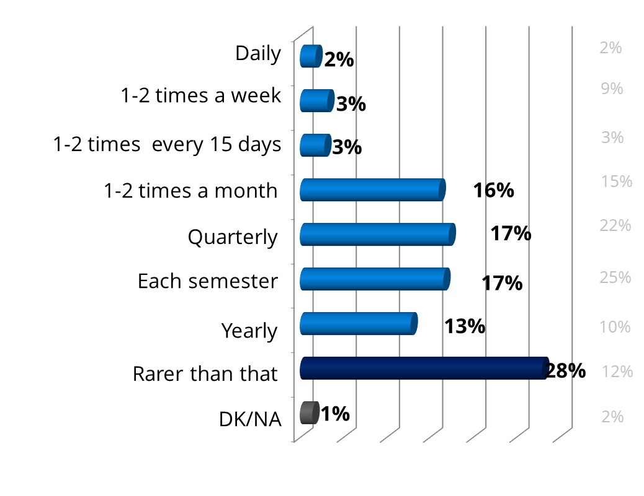
To meet your health / care needs, do you feel the need to move out of your place of residence?
How often?
_{DK / NA}
_{1%}
_{NO}
_{72%}
61%
_{YES}
_{27%}
38%

Slide 14
To meet your health / care needs, do you feel the need to move out of your place of residence?
Where?
_{DK / NA}
_{1%}
_{NO}
_{72%}
61%
_{YES}
_{27%}
38%
59%
33%

Slide 15
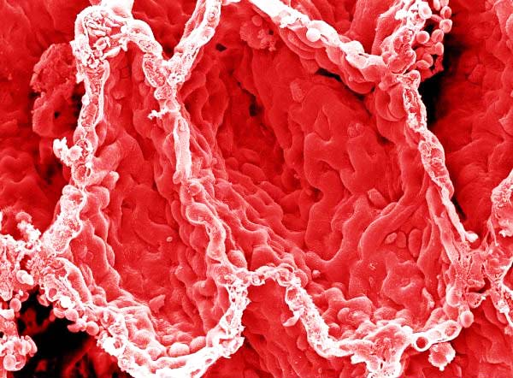


HEALTHCAREa thread to societies soon
Major challenges due to:
$
economic
crisis
population
ageing
chronic
conditions
today over 40% of the Europeans above the age of 15 live with a chronic condition
by 2050 more than 50% of the Europeans
will be in retirement

Slide 16
Who is most in risk?
the poor
the disabled
those in remote areas
those in social isolation

Slide 17
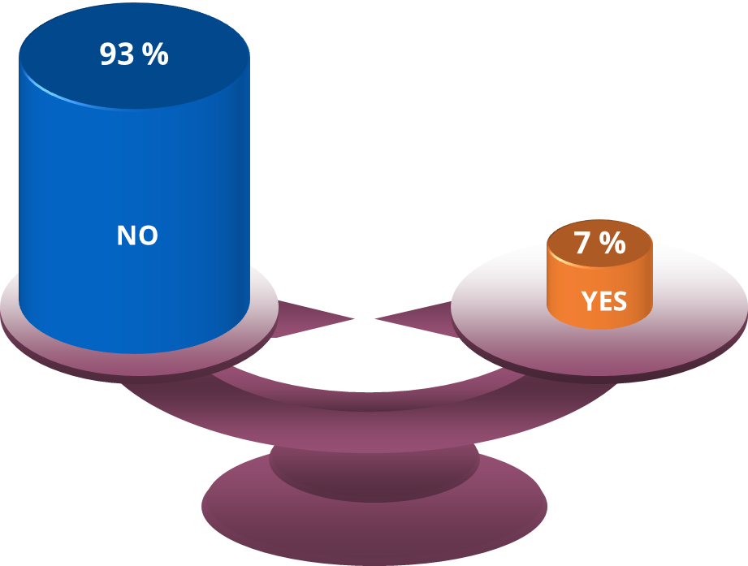

Are you a person with limited mobility and/or independence
due to health issues or disability?
Are you a relative (parent or brother/sister or child) or guardian of such a person?

Slide 18

In fact…
Significant parts of the population living in the CB area…
suffer from low access to health and social services

Slide 19
and therefore…
it is essential to come-up with
new solutions
at lower, sustainable costs
in a “holistic health” approach
placing self-care and preventive medicine on a continuum with
health care providers

Slide 20

The project’s vision
To establish inclusive health and social services
free of accessibility barriers
taking care of disadvantaged and high-risk citizens
facilitating CB management and use of the health and medical data
Thus promote early prevention, safe ageing and independent living for all

Slide 21

The project will establish…
an integrated cloud-based platform for better management and access to personal health data and records
1

Slide 22

The project will establish…
two prototype reference centers where vulnerable citizens may receive information, personalized support and primary healthcare services
2

Slide 23
Staffed with experts and new equipment
generate and maintain an accurate PHR (health logistics), incl. digitizing their paper-based records
offer personal support and specialized primary healthcare services, onsite and at the citizen’s space (mobile units)
provide information (available services, accessibility information)
act as an information desk for medical tourists
help citizens improve their self-awareness and self-management (health advisors & seminars)

Slide 24

Further outputs
A joint CB study of gaps and inequalities
Strategy and Action Plans for addressing the needs of vulnerable and special groups
Information on accessible health and social services available in the CB area, as a result of systematic inspections and data collection across the region (Guide in accessible formats and online)
Workshops and seminars for (a) staff of the units, (b) professionals, and (c) citizens

Slide 25



offer access to eLearning for citizens (health & digital health literacy)
e-Learning
web platform (D4.2.3)
allow citizens to create and maintain their own ePHRs (optionally, with the support of the staff of the centers)
allow citizens to import data to their own ePHR, automatically from connected/supported devices
allow citizens to share data of their ePHRs, in a user-friendly manner, with health professionals across the borders
offer information on services, including information about access and accessibility
support the operation of a volunteer programme
offer access to resources for professionals
offer access to resources for citizens
offer info about & access to ePHR, eLearning, e-Prescription and e-Referral
PHR
web platform (D4.1.2)
PHR mobile app
for citizens (D5.2.2)
allow automatic (i.e., easy and free of error) importing of data from third party systems that it interfaces with (e.g., existing healthcare electronic systems of various healthcare authorities, including national prescription systems, hospital electronic systems, private telecare services, etc.)
Cross-border
web portal (D4.3.1)
CB mobile app
for citizens (D5.3.3)
e-Prescription &
e-Referral (D4.2.4)
PHR mobile app
for pros (D5.1.1)

Slide 26
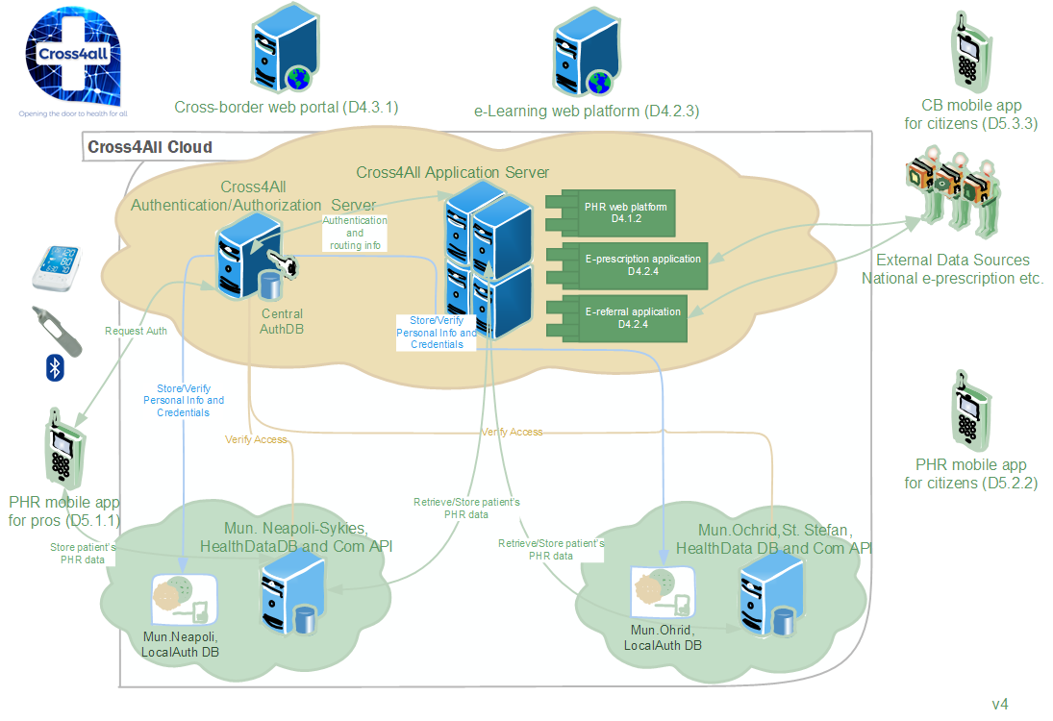

Slide 27









e-Prescription &
e-Referral (D4.2.4)
D5.x.1
9
Cross-border
web portal (D4.3.1)
PHR mobile app
for pros (D5.1.1)
8
Info & resources database
1
6
5
CB mobile app
for citizens (D5.3.3)
PHR web
platform (D4.1.2)
2
4
e-Learning
database
D5.x.2
PHR database
3
e-Learning
web platform (D4.2.3)
7
PHR mobile app
for citizens (D5.2.2)

Slide 28

Project Sticker

