Slide 1
Progress and plans of PB3
5th Project Meeting, 25-26 November 2019
Host: Municipality of Neapolis-Sykies (PB5)
Venue: CAPSIS HOTEL, Monastiriou 16, 54629 Thessaloniki

Slide 2
Status of staff recruitments
Staff #1 - assigned
  Local Project & Financial Manager (D1.3.2)
  Person for reviewing the final strategy (D3.3.3)
  Member of the Monitoring & Support Committee for the Pilot Programme (incl. equipment acquisition)
WP | Del. | Item | Brief justification of the expenditure (Max 350 Characters)
WP1 | D1.3.2 | Project manager | 1 Person responsible for the management of the project (reporting, monitoring, etc.) - part time (24 months X 20 hrs per month)
WP3 | D3.3.3 | Technical Staff | 1 Person responsible for reviewing and editing the Final Deliverables of NCDP (Contribution to Joint Strategy and Action Plan with emphasis on inclusive social/health care practices, Guide in print and accessible formats for people with disabilities)
WP6 | D6.3.3 | Technical Staff | Member of the Monitoring & Support Committee for the Pilot Programme of the Municipalities (P2 and P5). 6 months X 56 hrs / month X 15€ per hour

Slide 3
Status of Tenders
Tender #1:
  Related to: D1.3.5 – FLC (assigned)
  Budget: €5.000 (incl. VAT)
  Status: Contract to be signed
Tender #2:
  Related to: D1.3.4 (External management support)
  Budget: €11.904,00 (incl. VAT)
  Status: Tender closed,
  Contract signed on 18.02.2019
Tender #3 (Open electronic tender):
  Related to: All eternal services
  Budget: €186.580,00 (incl. VAT)
  Status: Launched on 06.11.2019 for
  Deadline for offers: Today
  Running: Tomorrow, 10am
https://www.esamea.gr/projects-tenders/calls/4411-ilektronikos-anoiktos-diagonismos-kato-ton-orion-gia-tin-epilogi-anadoxoy-toy-ergoy-paroxi-ypostiriktikon-kai-meletitikon-ypiresion-gia-tin-ylopoiisi-draseon-tis-praxis-cross4all
D2.3.2 Communication material and tools
D2.3.3 Public Project Events
D2.3.4 Project website (WCAG 2.0, AA)
D3.3.1 Joint study of needs and gaps
D3.3.2 Inspections and data collection
D3.3.3 Common strategy & action plan
D3.3.3 Common strategy & action plan
D3.3.5 Awareness and activation raising campaign
D3.3.5 Awareness and activation raising campaign
D4.3.1 Cross-border Portal for accessible health services
D5.3.3 Mobile app for citizens & medical tourists

Slide 4
Implementation progress and status
There was no significant progress to be reported in this period
(given that the procurement procedure for the NCDP's activities in WP2-WP5 is not completed yet)

Slide 5
Next steps
Will sign contract with the winning applicant and focus on the implementation of:
  D2.3.2 (communication materials)
  D2.3.4 (www.cross4all.eu)
  D3.3.1 (study on user needs – meta/comparative analysis)
  D3.3.2 (accessibility inspections)
  D4.3.1 (cross-border portal for accessible services)
Will be attending the project study visits
Will support their organization:
  In contact with J Patrick Clarke, Advocacy Consultant, President of European Down Syndrome Association, Vice President, European Disability Forum (he is the past Chair of the Disability Federation of Ireland)
  will also enlist the assistance of our fellow board member Senator John Dolan

Slide 6
Status of expenditures
Paid out and verified expenditures until 31.06.2019
  Contracted: €19.104 (9%)
  Paid out: €9.025,40 (4,08%)
  Verified: €0,00 (to be contracted these days)
Expected paid out expenditures until 31.12.2019
  Total: €15.500,00 (7%)

Slide 7
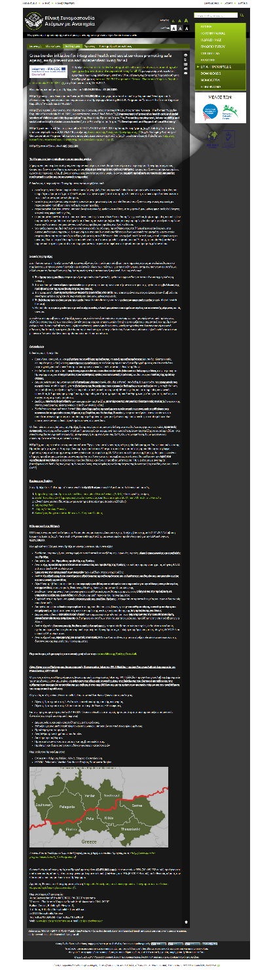
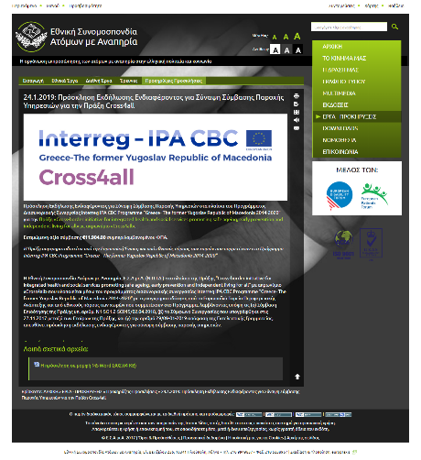
Publicity outcomes and plans
OUTCOMES:
PB3: Announcement of the Project on PB3’s web page: http://tiny.cc/wj0f2y
PB3: Announcement of the tender #2 on PB3’s web page: http://tiny.cc/b8s83y
Poster of the project, developed using the MA's “Poster Development Tool” and placed it in visible places of the premises of PB3 (Athens, Thessaloniki)
PLANS:
Communication material & tools (D2.3.2)
Closing (or Opening) event Thessaloniki (D2.3.3)
Project website (WCAG 2.0, AA) (D2.3.4)

