Slide 1
Progress and plans of Municipality of Neapoli-Sykies
Presenter: Sofia Mizamtsi
4th Project Meeting, 25-26 November 2019
Host: Municipality of Neapoli-Sykies (PB5)
Venue: CAPSIS HOTEL, Monastiriou 16, 54629 Thessaloniki

Slide 2
Status of staff recruitments
  There are no pending assignments
Reference D1.5.2, D3.5.3, D6.5.1
Staff - assigned - D1.5.2
  Local Project & Financial Manager: Giannis Polychroniadis
  Scientific Coordinator: Maro Vassara
  Staff - assigned (Nov ’18 contracted-Sofia Mizamtsi ) - D1.5.2, D3.5.3, D6.5.1
  Local Project Manager Assistant
  Preparing & monitoring the tenders
  Coordinator of the Pilot Programme

Slide 3
Status of staff recruitments
✓
WP | Del. | Item | Brief justification of the expenditure (Max 350 Characters)
WP1 | D1.5.2 | Project manager | 1 Person (Local Project and Financial Manager) responsible for the management of the project (reporting, monitoring, etc.) - Part time
WP1 | D1.5.2 | Administrative staff | 1 Person (Local Project Manager Assistant) will be hired to support the Local PM. Part time
WP3 | D3.5.3 | Technical Staff | 1 Person responsible for preparation and monitoring of the tenders and for reviewing and editing the Final Deliverable of the Municipality
WP6 | D6.5.1 | Other | Coordinator of the Pilot Programme. Part time
Staff recruitments in numbers (31/10/2019)
  Approved Budget: 28.132,50 €
  Contracted Budget: 28.132,50 € (1.200,0+26.932,5)
  Invoiced Budget: 15.301,79 € (54,4%)
  Paid out expenditures: 15.301,79 € (54,4%)

Slide 4

Status of Tenders
Tender #1:
  Related to: D3.5.3, D3.5.4, D3.5.5 (strategy, workshops, awareness)
  Budget: €21.889,98 (incl. VAT)
  Status: Tender published 12/2/2019
          Contract signed 1/4/2019, until 31/12/2019 (€21.073,80)
Tender #2:
  Related to: D1.5.3, D2.5.3 (Project meeting and Project event)
  Budget: €3.927,01 (incl. VAT)
  Status: Published 22/4/2019
          Contract signed 25/5/2019, until 31/3/2020 (€3.837,80)
Tender #3:
  Related to: D4.5.5, D5.5.1, D5.5.2 (Equipment)
  Budget: €50.899,98 (incl. VAT)
  Status: - Published 2/7/2019
  - Re-published 1/10/2019 (Medical equipment & Computer devices)
  - Contracts will be signed asap for Groups B, C, D
  - Will be republished asap for Group A Infokiosks (exclusion due to a missing document in the 1st tender)

Slide 5
Status of Tenders
Tender #4:
  Related to: D4.5.5, D6.5.1, D6.5.2 (Pilots)
  Budget: €99.299,93 (incl. VAT)
  Status: - Published 5/8/2019 - No offers submitted
      - Republished 22/11/2019 - Opening of offers 18/12/2019
Tender #5:
  Related to: D1.5.5 – FLC
  Budget: €5.000 (incl. VAT)
  Status: Terms of References completed
  Invitation to be announced in 2020-as soon as MA send FLC
            The Request for designation of a FLC was submitted on 31/10/2019

Slide 6
Status of Tenders
Tenders in numbers
  Approved Budget: 181.017,00 €
  Contracted Budget: 24.911,60 € (14%) (3.837,80+21.073,80)
  Invoiced Budget: 0 €
  Paid out expenditures: 0 €

Slide 7
Status of expenditures
  Contracted
  53.044,10 € (25% of total, Staff 100%)
  Paid out until 31/10/2019
  15.592,30 € (7,3%)
  Verified until 31/10/2019
  0 € Request of FLC submitted 31/10/2019 (15.592,30€)
  Expected paid out expenditures until 31/12/2019
    25.018,48 € (11,8%)
    [Forecasts in the first semester 2020: 172.389,22 €]

Slide 8
Implementation progress
  WP 1
Del | Budget line | Situation / Problem / Issue
D1.5.2 | Staff costs | Contracted
D1.5.2 | Office & administration | Budget modification needed: 504,5 Euro > staff costs
D1.5.3 | Travel & accommodation | Plan appropriately future Project Meetings Budget modification may be needed
D1.5.3 | External Expertise & Services | Contracted on May 2019 [Project meeting]
D1.5.5 | Audits (FLC) | Request of FLC submitted on 31/10/2019 Designation of FLC will be in 2020

Slide 9
Implementation progress
  WP 2
Del | Budget line | Situation / Problem / Issue
D2.5.3 | External Expertise & Services | Contracted on May 2019 [Closing event]

Slide 10
Implementation progress
  WP 3
Del | Budget line | Situation / Problem / Issue
D3.5.3 | Staff costs | Contracted on November 2018
D3.5.3 | External Expertise & Services | Contracted on April 2019 – finishing 31/12/2019 [Joint strategy] Dependence on Del of other Partners
D3.5.4 | External Expertise & Services | Contracted on April 2019 – finishing 31/12/2019 [Educational material] Dependence on Del of other Partners
D3.5.5 | External Expertise & Services | Contracted on April 2019 – finishing 31/12/2019 [Seminar – Workshop] Dependence on Del of other Partners

Slide 11
Implementation progress
  WP 4
Del | Budget line | Situation / Problem / Issue
D4.5.5 | Equipment | Tender for infokiosks will be republished asap
D4.5.5 | External Expertise & Services | No offers were submitted in the 1st tender [Pilot programme] Tender republished on 22/11/2019 Opening of offers 18/12/2019

Slide 12
Implementation progress
  WP 5
Del | Budget line | Situation / Problem / Issue
D5.5.1 | Equipment | To be contracted: Medical equipment, PC & devices
D5.5.2 | Equipment | To be contracted: Medical equipment, PC & devices

Slide 13
Implementation progress
  WP6
Del | Budget line | Situation / Problem / Issue
D6.5.1 | Staff costs | Contracted on November 2018
D6.5.1 | External Expertise & Services | No offers were submitted in the 1st tender [pilot programme] Tender republished on 22/11/2019
D6.5.2 | External Expertise & Services | No offers were submitted in the 1st tender [pilot programme] Tender republished on 22/11/2019 Opening of offers on 18/12/2019
D6.5.5 | Travel & accommodation | Multiple communications to PB6 for finalization & scheduling of study visits Further delays may affect participation of the Municipality

Slide 14
Implementation progress
  D6.5.5
  Study visits ?
Multiple communications to PB6 for finalization & scheduling of study visits
Further delays may affect participation of the Municipality

Slide 15
Implementation progress
  PB5’s WP3 Deliverables
  Delay in D3.5.3, D3.5.4, D3.5.5 is mainly due to the dependence with Deliverables from other Partners.
  Material required for appropriate implementation:
  PB3 - NCDP
    - D3.3.1 Desk research & questionnaire-based interview
    - D3.3.2 Development of common evaluation system for assessing
    accessibility & inspection results
    - D3.3.3 Guide for citizens
  PB4 - Municipality of Ohrid
    - D3.4.2 Public opinion poll with 2000 minimum people
    - D3.4.2 Inspection results
  PB6 - Institute St. Stefan
    - D3.6.4 Guide for professionals (expertise on accessibility for disabled people & serving vulnerable groups)

Slide 16
Implementation progress
  Proposed solution
  Project extension request: 6 months
  Emerging issue
  Must manage funds for the extension
  Modification needed
  Transfer budget between budget lines & deliverables
  from external expertise & services to staff costs, i.e. savings from tenders, due to lower offers (1577,02 € until today)
  from office & administration (504,50€) to staff costs
  from travel & accommodation to staff costs (if study visits will be cancelled & if there will be no future project meeting in Northern Macedonia)

Slide 17
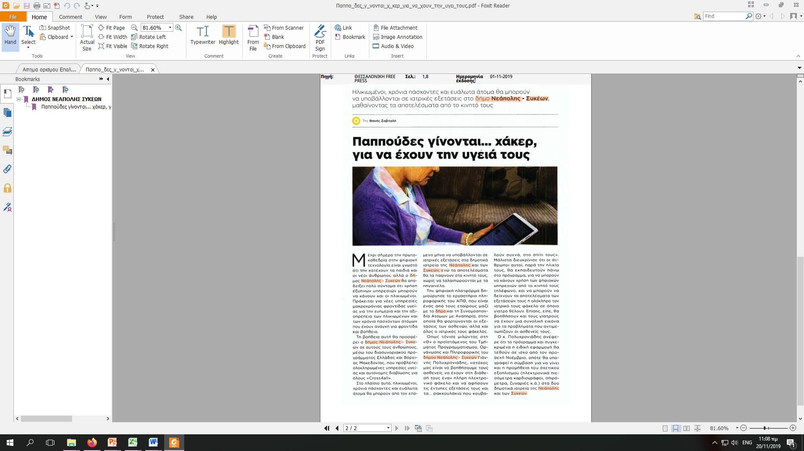
Publicity outcomes and plans
Outcomes
Respecting publicity rules/measures for all invitations & tenders disseminated
Following Communication Plan of the Project
Diffusing with every chance Cross4all Project, i.e. articles on newspapers, meetings & conferences of the Municipality

Slide 18
Publicity outcomes and plans
Plans:
Closing event in Thessaloniki in 2020
[Contracted on May 2019]

Slide 19
Thank you for your attention
Enjoy your stay in Thessaloniki

