Slide 1
State of Play
5th Project Meeting, 25-26 November 2019
Host: Municipality of Neapolis-Sykies (PB5)
Venue: CAPSIS HOTEL, Monastiriou 16, 54629 Thessaloniki

Slide 2
Introduction
The purpose of this first presentation is to provide and short overview on the current situation in the Project, and to:
highlight the progress made so far
identify key issues & critical delays in relation to the original plans
derive the main topics that we need to focus and discuss upon
set the primary objectives of this meeting

Slide 3
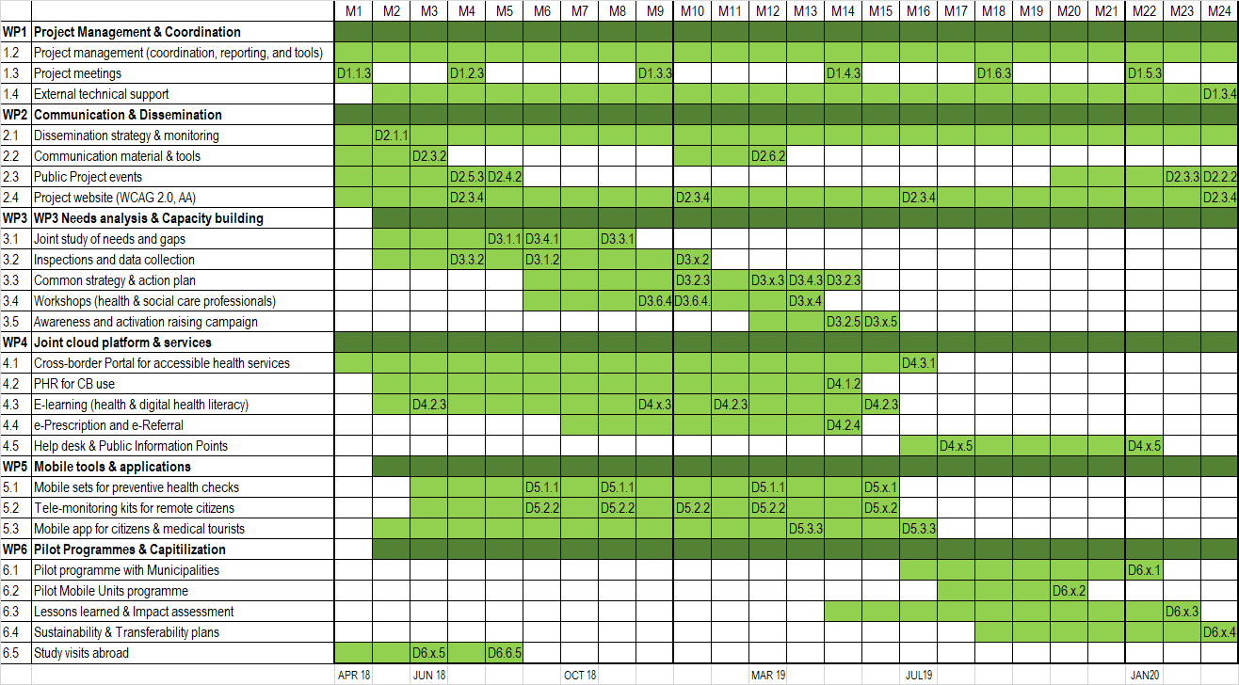
3rd Progress Report (15 months in the project)
2nd progress report
3rd progress report

Slide 4
3rd Progress Report (15 months in the project)
LB1 = €28.868,36 (11,5%)
PB2 = €510 (0,3%)
PB3 = €2.441,65 (1,1%)
PB4 = €897,95 (0,6%)
PB5 = €3.642,58 (1,7%)
PB6 = €816,63 (0,6%)
Total = €37.177,17 (3,3%)
LB1 = €99.259,91 (39,6%)
PB2 = €14.706,04 (8,2%)
PB3 = €9.025,40 (4,1%)
PB4 = €2.915,97 (2,0%)
PB5 = €11.030,24 (5,2%)
PB6 = €816,63 (0,6%)
Total = €137.754,19 (12%)
2nd progress report
3rd progress report

Slide 5
3rd Progress Report (15 months in the project)
Verified: 29% (11,5%) Contracted: 66%
LB1 = €99.259,91 (39,6%)
PB2 = €14.706,04 (8,2%)
PB3 = €9.025,40 (4,1%)
PB4 = €2.915,97 (2,0%)
PB5 = €11.030,24 (5,2%)
PB6 = €816,63 (0,6%)
Total = €137.754,19 (12%)
Contracted: 71%
Contracted: 9%
Contracted: 6%
Contracted: 25%
Contracted: <1%
3rd progress report

Slide 6
2nd Progress Report (9 months in the project)
Key conclusions:
LB1 expenditures follow smoothly the timing of the Project
PB2 has now contracted over 70% + started making expenditures (no verifications yet)
PB5 has now contracted over 25%, to be significantly increased soon (no verifications yet)
PB3, PB4, PB6 contracting is falling behind significantly (risks to be assessed)

Slide 7
Overview of progress & major delays

Slide 8
I&P materials
Opening event in Thessaloniki
Project website
Video
tech dev
Study visits
Study by PB4
Guide for seminars
Draft strategy
Inspections
PR3
PR4
today
<4 months
Pushing behind the common strategy & the workshops

Slide 9
today
Next stage
Complete the developments
Initiate the pilots

Slide 10
Main topics and objectives for this meeting
Assess underperformance risk & take joint decisions as necessary
  Additional measures need to be discussed and agreed (to enhance publicity, project extension, etc.)
  The action plan for each partner, for the next period needs to be made clear and binding
Next period planning
  Plan all WP3 activities (complete and close)
  Completing the tech developments (WP4 & WP5)
  Plan the initiation of the pilots (WP6)

Slide 11





Alexandros Mourouzis
Lab of Computing, Medical Informatics, and Biomedical Imaging Technologies, Aristotle University of Thessaloniki

